Slide 1
Instructions Slide [not visible]
This document is intended to provide guidance for the design and implementation of Microsoft based security solutions in Azure and M365.
Shortcut URL: https://aka.ms/PartnerSocArchitecture
These diagrams are shared with Microsoft Partners focused on designing and deploying a range of solutions, including ASC, AAD, Microsoft Sentinel and improving the SOC architecture.
You may also use these designs to further develop your knowledge, create training, and challenge the way we think about implementing security.
An internal video accompanying this presentation is available at this link

Slide 2
DO NOT DELETE SLIDES
Please take a copy of this deck if you intend to make edits such as deleting slides you do not need
This is the master copy used by many individuals, any changes you make to this live deck are seen by everyone
Please be a good citizen ☺

Slide 3
Azure and Microsoft 365 Security Reference Architecture for production deployments
Microsoft Internal Use and Microsoft Partners Only

Slide 4
Contents
This is a living document that is constantly updated
Please provide your feedback to Richard.Diver@Microsoft.com
Introduction slides
SOC Architecture Overview
Data Management
Microsoft Sentinel Pricing Guide
Microsoft Defender for IoT
AWS Integrations
GCP Integrations
Modern Workplace Compliance

Slide 5


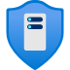




Azure Network Security: Protection services enabling zero trust
DDoS protection
Web Application Firewall
Azure Firewall
Network Security Groups
VNET Integration
DDOS protection tuned to your application traffic patterns
Centralized inbound web application protection from common exploits and vulnerabilities
Data exfiltration protection using centralized outbound and inbound (non-HTTP/S) network and application (L3-L7) filtering
Distributed inbound & outbound network (L3-L4) traffic filtering on VM, Container or subnet
Restrict access to Azure service resources (PaaS) to only your Virtual Network using VNET Injection, Private Link and Service Endpoints
Application protection
Segmentation
Notes:
Protection to your Azure service resources from the internet by allowing access only to your Virtual Network

Slide 6
Questions you can ask any customer…
Does your customer have a mature SOC already ?
4. Operational Practices:
What is the SOC structure, capabilities, and level of automation
Are you using PAWs or PAM solution to run your SOC operations securely ?
Operational excellence : Are you measuring your SOC effectiveness with KPIs (MTTR/MTTD) ?
1. Risk Framework:
What drives decisions when it comes to GRC
How much risk are they willing to accept
2. Controls Framework:
What frameworks are followed to achieve governance requirements
5. Assurances:
Provide a short checklist of the recommended extras that should be in place:
Red Team exercises to test their security architecture and Incident Response procedures
What frameworks are followed to validate threat detection capabilities and raise SOC awareness (e.g Mitre Att&ck)
Cyber insurance to help cover costs after breach
IR retainer to ensure expedited response when necessary
Investment in technology and people: where are the gaps?
3. Security Solution Architecture:
What has been implemented to manage risk
Is the solution architecture well documented
Is there a reference framework in use to identify gaps
Notes:
What is your audience?
- customers that need to reset expectations and assess how they got here…
- Microsoft and partner field that needs to articulate approach and benefits, before selling more stuff
- do “these things” before doing too deep into the weeds and buying more tools
what are the drivers....
- something might happen (pain avoidance)
- something already happened (recoil)
= need to confirm status or change approach
Suggest they review
- Risk framework (ISO 27001 is easy, CMMI is heavy but good. to be delivered by MCS or a partner)
- Controls framework (NIST, many others)
- Security solutions architecture (Microsoft can provide a template)
- Operational practices (ITIL / Modern SOC)
- Assurances (Premier and 3rd party)
what are the next steps...
- strengthen identity posture!
- workshops to run compliance score to test current state:
- Microsoft 365
- Azure Security Center
Possible outcomes of this discussion:
Need to create an info graphic that helps to articulate the options and levels of maturity from simple to "I have a Risk Officer"
A lot of this is outside of Microsoft tools and services, needs to expand into partners to provide a full answer
Could list a few of our solutions that are well aligned

Slide 7
Content overview
Clickable Navigation Page
Architecture Review:
SOC Security Architecture
MSSP Specifics
Log collection & analysis
Cyber Threat Intelligence
WAF/FW
SIEM and SOAR
CSPM / CWPP
IAM architecture
Notebooks/Playbooks
Advanced Threat Protection:
Cloud App Security
Endpoint Detection & Response
Data Loss Prevention
Insider Threat
Networks
Skills Assessment:
SOC training opportunities
Threat Expert integration
Red Teaming
Tabletop / Lab exercises
Key Themes:
Cost optimization
Consolidation / Simplification
Zero Trust Architecture
Zero Trust Network Access
SASE
Attack Surface Reduction
Threat Vulnerability Management
Cyber Incident Response
BCP & DR
IT/OT Divide
SOC Process Improvement:
Risk Advisory Board
Architecture as a Service
Use-case scenario development
Log data mapping
Detection logic
Response automation
Ticket integration
SecDevOps
Summary:
Partner opportunities
Resources & Action items
Feedback

Slide 8
Latest news and capabilities
Microsoft Sentinel: https://aka.ms/asnew
Azure Charts: https://aka.ms/aznew
Internal Only:
Roadmap slides: https://aka.ms/SentinelRoadmapPowerpoint
Latest recording: https://aka.ms/SentinelRoadmapRecording

Slide 9
SOC Architecture Overview Modern approach to SOC implementations
Microsoft Internal Use and Microsoft Partners Only

Slide 10
Microsoft Sentinel for Global SOC
Reference Architecture
GSOC
Individual Business Units/Regions
Global SOC Operations
Azure Subscription 1
Region 1
Azure Subscription 2
CI/CD Pipeline
Azure Lighthouse
Logic Apps
SOC Collaboration
M365 Subscription
Microsoft Sentinel
Workbooks
Microsoft Sentinel API
Log Analytics
Teams for secure collaboration and communication
Optional
Cross Workspace Incident View
Customer Identity
Azure AD: Tenant 3
Logic Apps
B2B
Microsoft Sentinel
Region2
CA
Log Analytics
Region 3
PIM
SOC Identity
Azure AD: Tenant 2
Notes:
This next design articulates the split of identities on the left, as well as the discussion point of using Microsoft Sentinel in the partner tenant to build out their rules and queries prior to running against their customers (could use dev/test environment for this).
The next point to articulate is the identity integration between the MSSP and the customer:
B2B invites only, using entitlement management to automate (when it supports Roles)
No need to create/delete accounts in the customers tenant, however, there could be a good design practice to create a “firecall account” in the customer tenant in case of emergency access is required (cloud only account, highly monitored for mis-use, may not have CA policy applied if MFA outage is a concern)
This works well for an MSSP that has a regular turnover (15-30% per year) as they can automate the
Also provides the key benefit of obfuscation of their team's identities to their customers
Reiterate that the Microsoft Sentinel instance on the left will NEVER contain customer data.
Customer data ALWAYS stays in the customer tenant on the right (see next page)

Slide 11
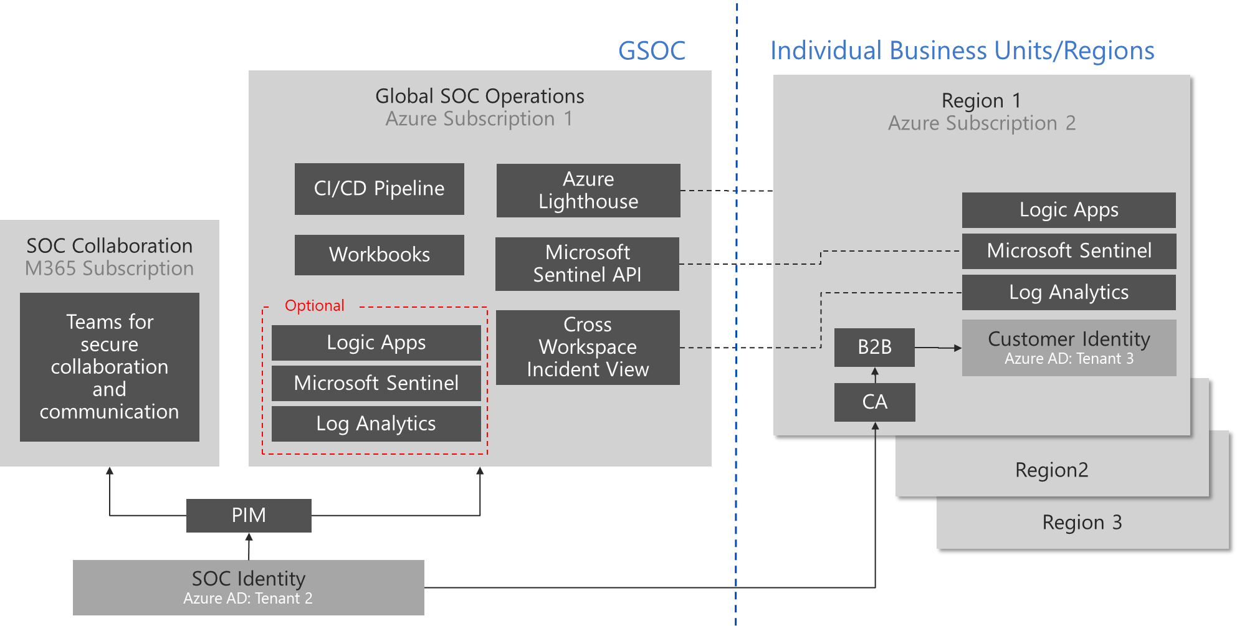
Microsoft Sentinel for Global SOC
Reference Architecture
Syslog
Customer Data
On-premises
Customer Data
Azure Subscriptions
Customer Data
Office 365 / AAD
Customer Data
Other Cloud Services
Notes:
Two key points to articulate here:
Can collect data from any source including:
Azure / Office 365
Any IaaS/PaaS/SaaS solution
On-premises (hybrid cloud)
Data ALWAYS goes into the customers tenant, never into the MSSP tenant

Slide 12
Microsoft Sentinel for MSSP
Partner
Customer
Reference Architecture
MSSP Operations
Azure Subscription 1
Customer 1
Azure Subscription 2
CI/CD Pipeline
Partner Admin Center
PAL Registration
Workbooks
Logic Apps
SOC Collaboration
M365 Subscription
Azure Lighthouse
Microsoft Sentinel
Protected IP
Log Analytics
Teams for secure collaboration and communication
Optional
Microsoft Sentinel API
Logic Apps
B2B
Customer Identity
Azure AD: Tenant 3
Microsoft Sentinel
Cross Workspace Incident View
Customer 2
CA
Log Analytics
Customer 3
Customer 4
PIM
MSSP Identity
Azure AD: Tenant 2
Notes:
Protecting MSSP IP: https://techcommunity.microsoft.com/t5/azure-sentinel/protecting-mssp-s-intellectual-property-in-azure-sentinel/ba-p/1420941
This next design articulates the split of identities on the left, as well as the discussion point of using Microsoft Sentinel in the partner tenant to build out their rules and queries prior to running against their customers (could use dev/test environment for this).
The next point to articulate is the identity integration between the MSSP and the customer:
B2B invites only, using entitlement management to automate (when it supports Roles)
No need to create/delete accounts in the customers tenant, however, there could be a good design practice to create a “firecall account” in the customer tenant in case of emergency access is required (cloud only account, highly monitored for mis-use, may not have CA policy applied if MFA outage is a concern)
This works well for an MSSP that has a regular turnover (15-30% per year) as they can automate the
Also provides the key benefit of obfuscation of their team's identities to their customers
Reiterate that the Microsoft Sentinel instance on the left will NEVER contain customer data.
Customer data ALWAYS stays in the customer tenant on the right (see next page)

Slide 13
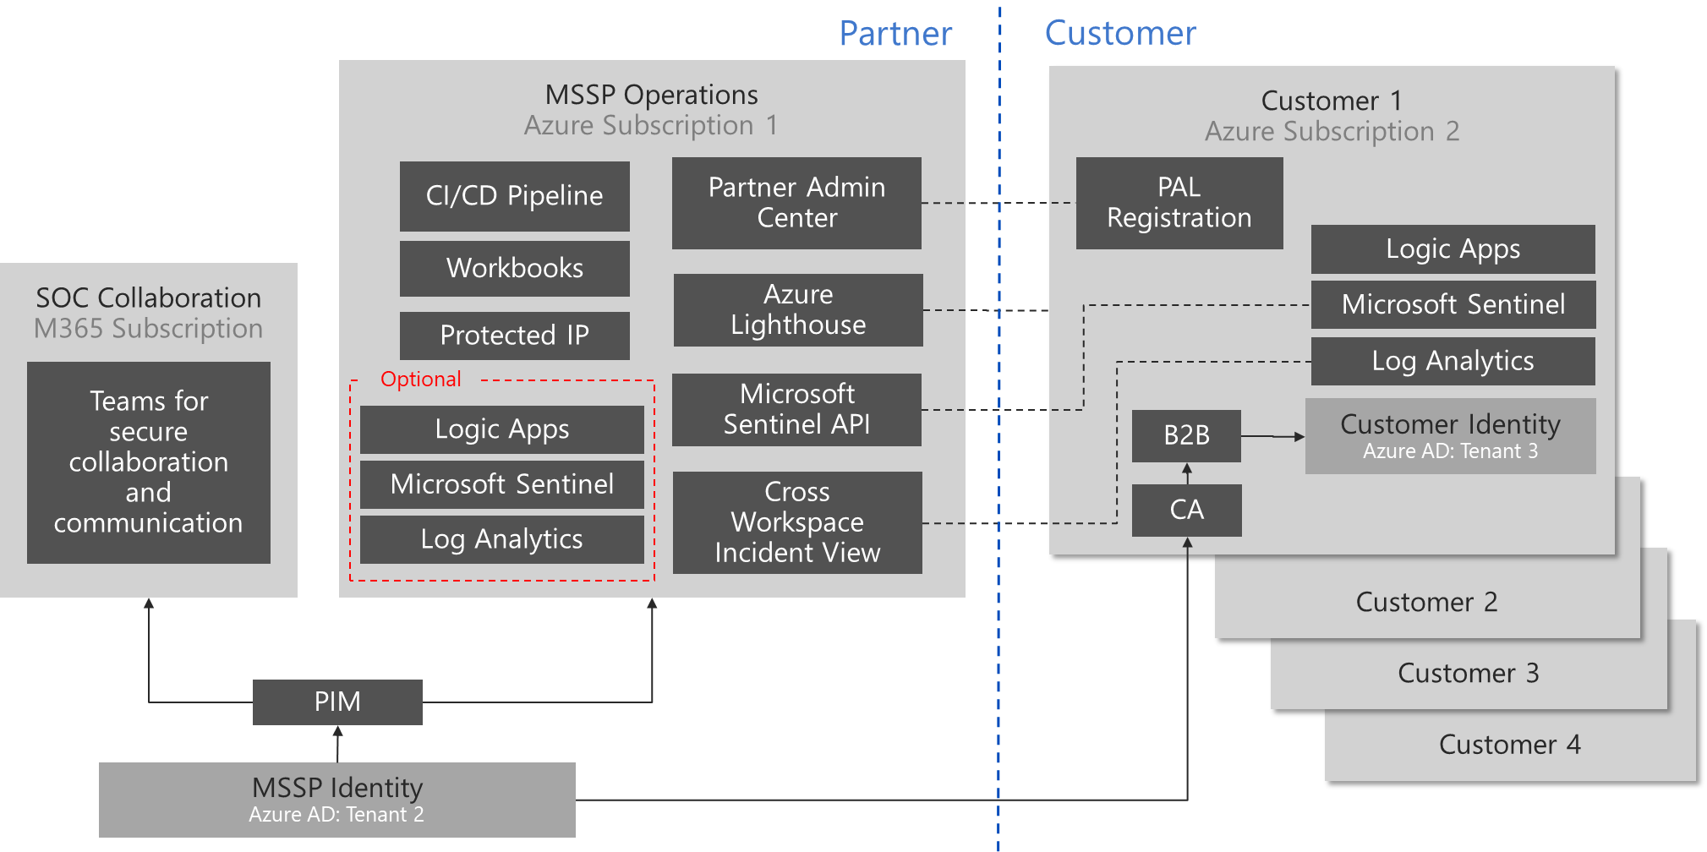
Microsoft Sentinel for MSSP
Reference Architecture
Syslog
Customer Data
On-premises
Customer Data
Azure Subscriptions
Customer Data
Office 365
Customer Data
Other Cloud Services
Notes:
Two key points to articulate here:
Can collect data from any source including:
Azure / Office 365
Any IaaS/PaaS/SaaS solution
On-premises (hybrid cloud)
Data ALWAYS goes into the customers tenant, never into the MSSP tenant

Slide 14
SOC Architecture for Complex Customer
Multiple Microsoft Sentinel Instances
IT Architecture
Global SOC Architecture
Regional SOC Tenants
SOC Collaboration
M365 Subscription
Global SOC Operations
Azure Subscription 1
ServiceNOW
SaaS Subscription
Region 1
Azure Subscription
Analysts and Hunters
Windows 10 PAW (Physical device)
Azure Lighthouse
Case Management
Microsoft Sentinel
SecOps (optional)
SOC Identity
Azure AD for IAM (passwordless)
Jupyter Notebooks
Identity & Access Management
Teams for secure SOC communications
Alert management
Subscription and resources
Cross workspace Incidents
Alert forwarding to MSSP SOC
PowerBI Internal & Customer Reporting
Analytics Rule
Ticketing integration
Workbooks
Security protection enablement
Logic Apps
Customer Internal IT
Corporate Tenants & Subscriptions…
Cross-tenant search
Data retention / warehouse
Azure KeyVault
Security Posture Management
Corporate Office 365
(email + collaboration)
Azure DevOps + Github
(CI/CD Pipeline)
Vulnerability & Risk Assessments
Incident Response
Company Identity
Red/Blue Team Exercises
DEV / TEST
Azure Subscription 2
SALES DEMO
Azure Subscription 3
Windows Virtual Desktop
Exec / Employee Training
Microsoft Sentinel
Microsoft Sentinel
Insider Risk Management
Microsoft 365 E5
Microsoft 365 E5
Data Loss Prevention
Notes:
SOC in a Box Workbook: https://github.com/rinure-msft/Azure-Sentinel/blob/master/Workbooks/SOCProcessFramework.json
Roles/Responsibility as organizational functions https://aka.ms/SecurityRoles
Security guidance mapped to these functions includes
Securing Privileged Access – Rapid Modernization Plan (RaMP) https://aka.ms/sparoadmap
Human Operated Ransomware – Mitigation Plan https://aka.ms/humanoperated
Azure Security Top 10 https://aka.ms/azuresecuritytop10
Azure Security Benchmark https://aka.ms/benchmarkdocs

Slide 15
SOC Architecture for MSSP
MSSP Technologies
Partner SOC Architecture
Customer Tenants
Partner IT Architecture
SOC Collaboration
M365 Subscription
MSSP SOC Operations
Azure Subscription 1
ServiceNOW
SaaS Subscription
Customer 1
Azure Subscription
Analysts and Hunters
Windows 10 PAW (Physical device)
Azure Lighthouse
Case Management
Microsoft Sentinel
SecOps (optional)
SOC Identity
Azure AD for IAM (passwordless)
Jupyter Notebooks
Identity & Access Management
Teams for secure SOC communications
Alert management
Subscription and resources
Cross workspace Incidents
Alert forwarding to MSSP SOC
PowerBI Internal & Customer Reporting
Analytics Rule
Ticketing integration
Workbooks
Security protection enablement
Logic Apps
Partner Internal IT
Corporate Tenants & Subscriptions…
Cross-tenant search
Data retention / warehouse
Azure KeyVault
Security Posture Management
Corporate Office 365
(email + collaboration)
Azure DevOps + Github
(CI/CD Pipeline)
Vulnerability & Risk Assessments
Incident Response
Company Identity
Red/Blue Team Exercises
DEV / TEST
Azure Subscription 2
SALES DEMO
Azure Subscription 3
Windows Virtual Desktop
Exec / Employee Training
Microsoft Sentinel
Microsoft Sentinel
Insider Risk Management
Microsoft 365 E5
Microsoft 365 E5
Data Loss Prevention
Notes:
Roles/Responsibility as organizational functions https://aka.ms/SecurityRoles
Security guidance mapped to these functions includes
Securing Privileged Access – Rapid Modernization Plan (RaMP) https://aka.ms/sparoadmap
Human Operated Ransomware – Mitigation Plan https://aka.ms/humanoperated
Azure Security Top 10 https://aka.ms/azuresecuritytop10
Azure Security Benchmark https://aka.ms/benchmarkdocs

Slide 16
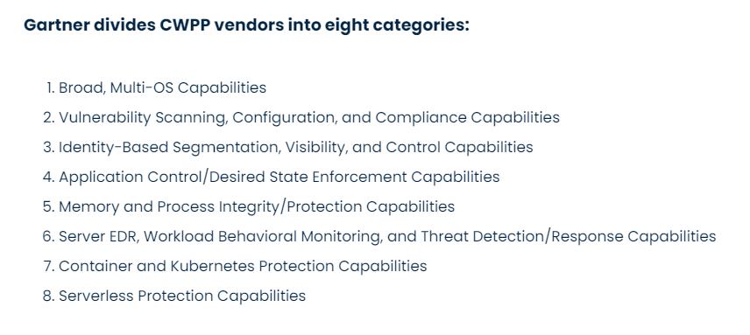
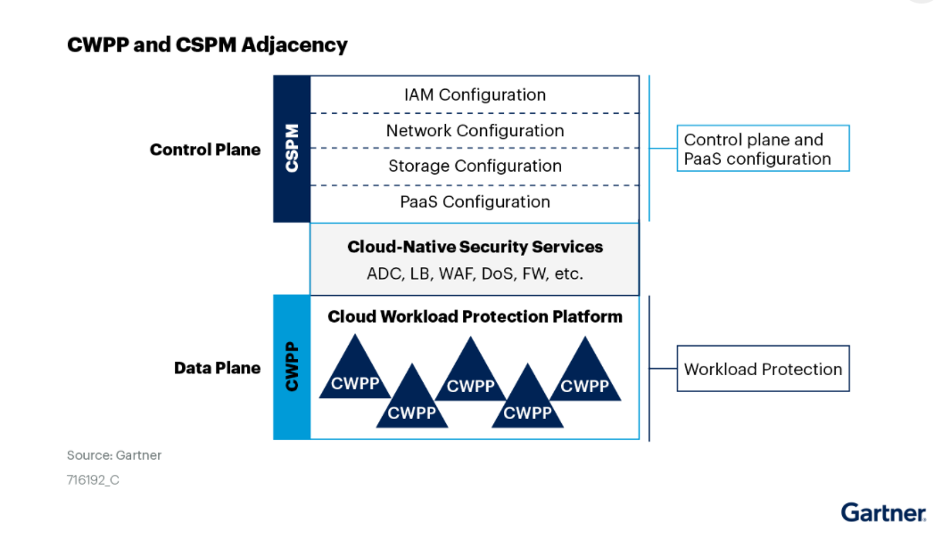
Mapping to Industry Trends & Terminology
Security Operation Center (SOC)
Cloud Security Operations
Security Information & Event Management (SIEM)
Microsoft Sentinel
Threat Intelligence (TI)
Microsoft Sentinel + 3rd Party
External Attack Surface Management (EASM)
RiskIQ (new for 2022)
Security Orchestration & Automated Response (SOAR)
Azure Logic Apps
Cloud Native Application Platform Protection (CNAPP)
Cloud Infrastructure Entitlement Management (CIEM)
CloudKnox (new for 2022)
Azure AD: Entitlement Management, Identity Governance, Privileged Identity Management, Access Reviews
Cloud Security Posture Management (CSPM)
Cloud Workload Protection Platform (CWPP)
Azure Security Center Microsoft Defender for Cloud
Extended Detection & Response (XDR)
Endpoint Detection & Response (EDR)
Defender for Endpoint (client and server)
Cloud Access Security Broker
(CASB)
Defender for Cloud Apps

Slide 17




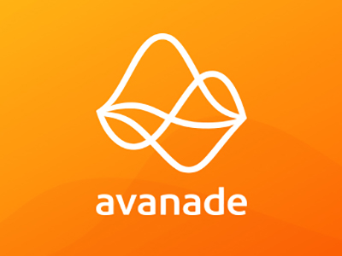


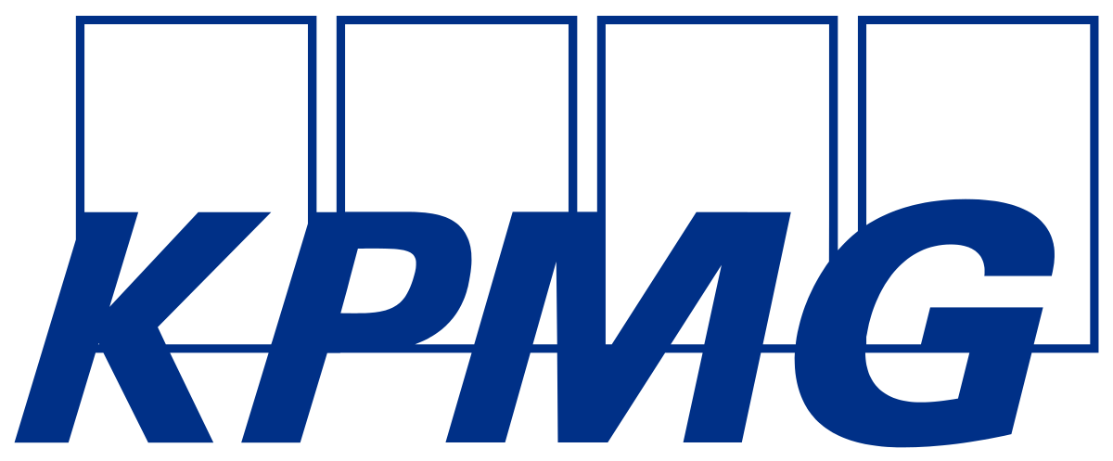
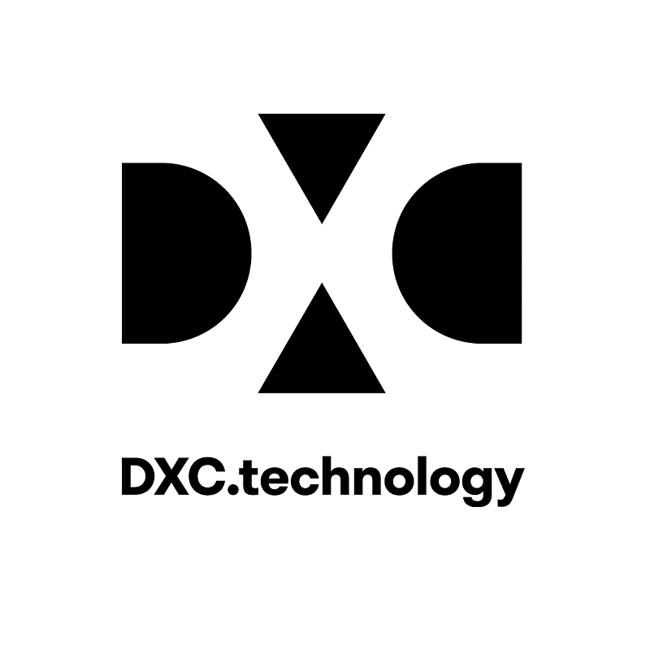


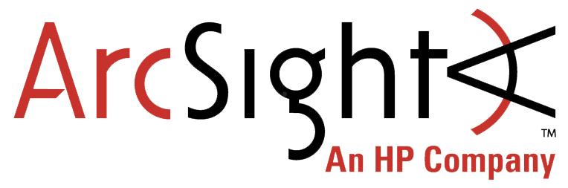
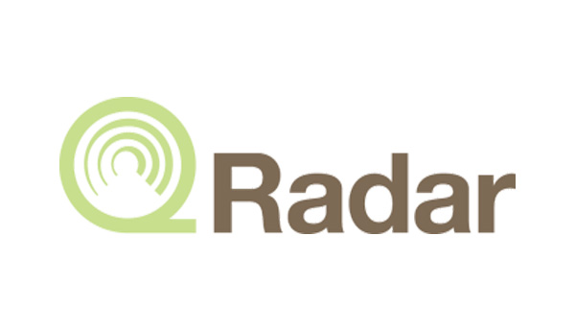
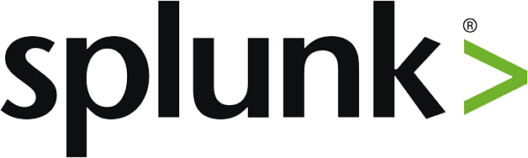
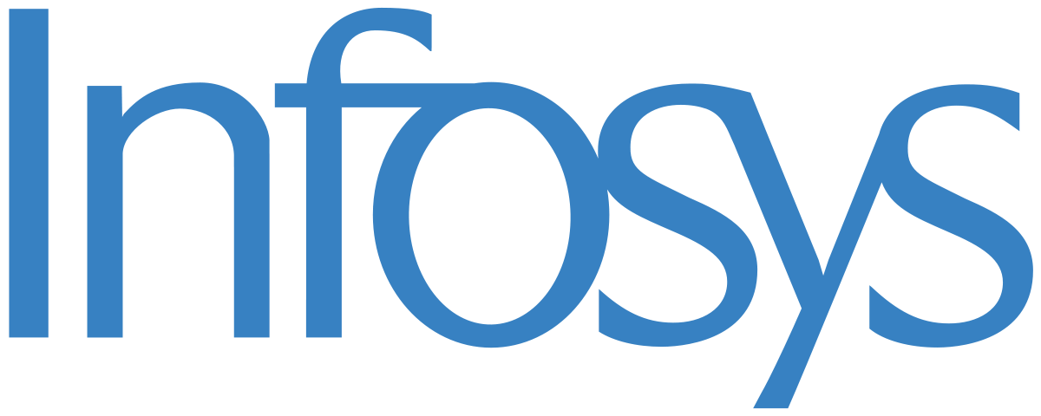
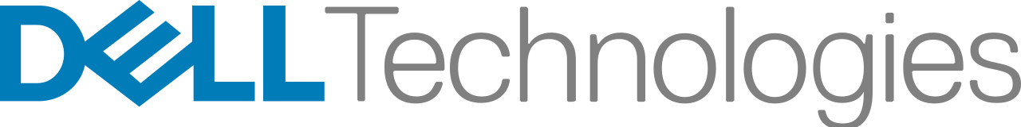





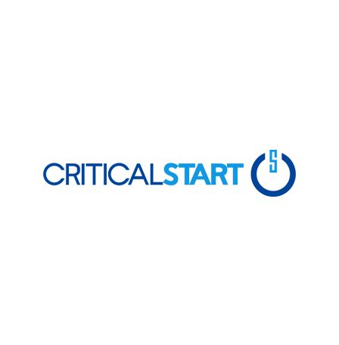
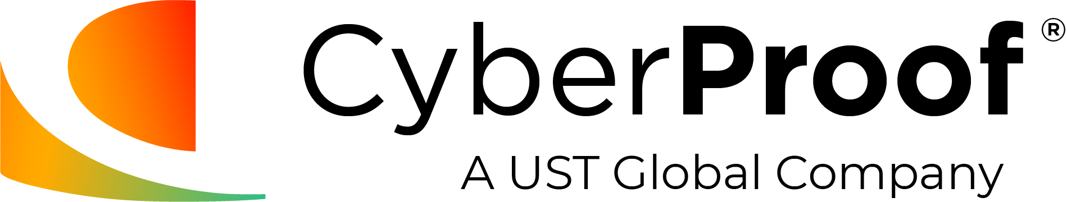

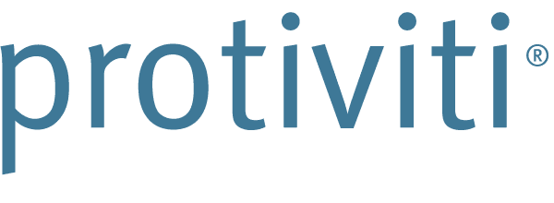
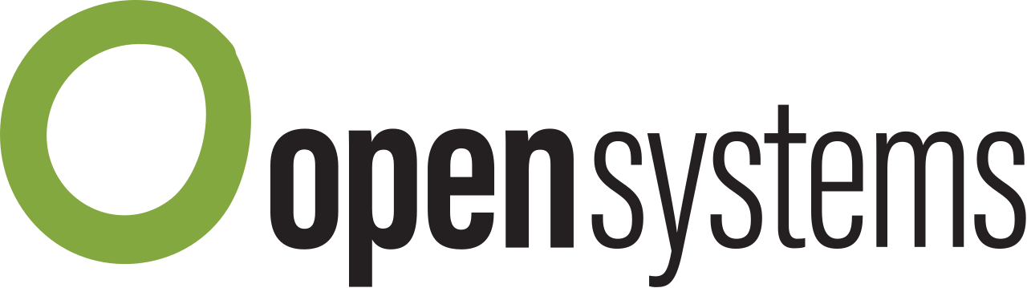
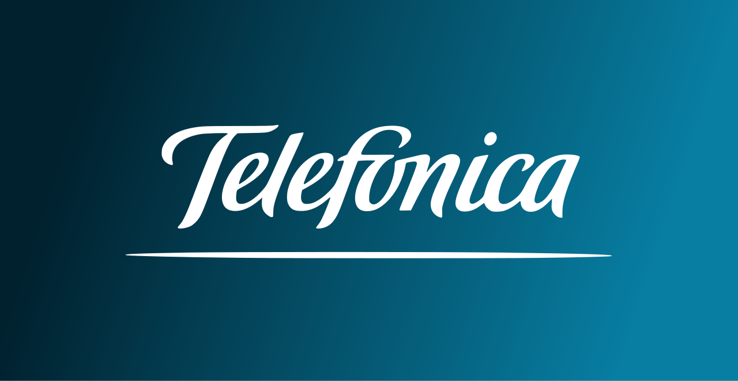
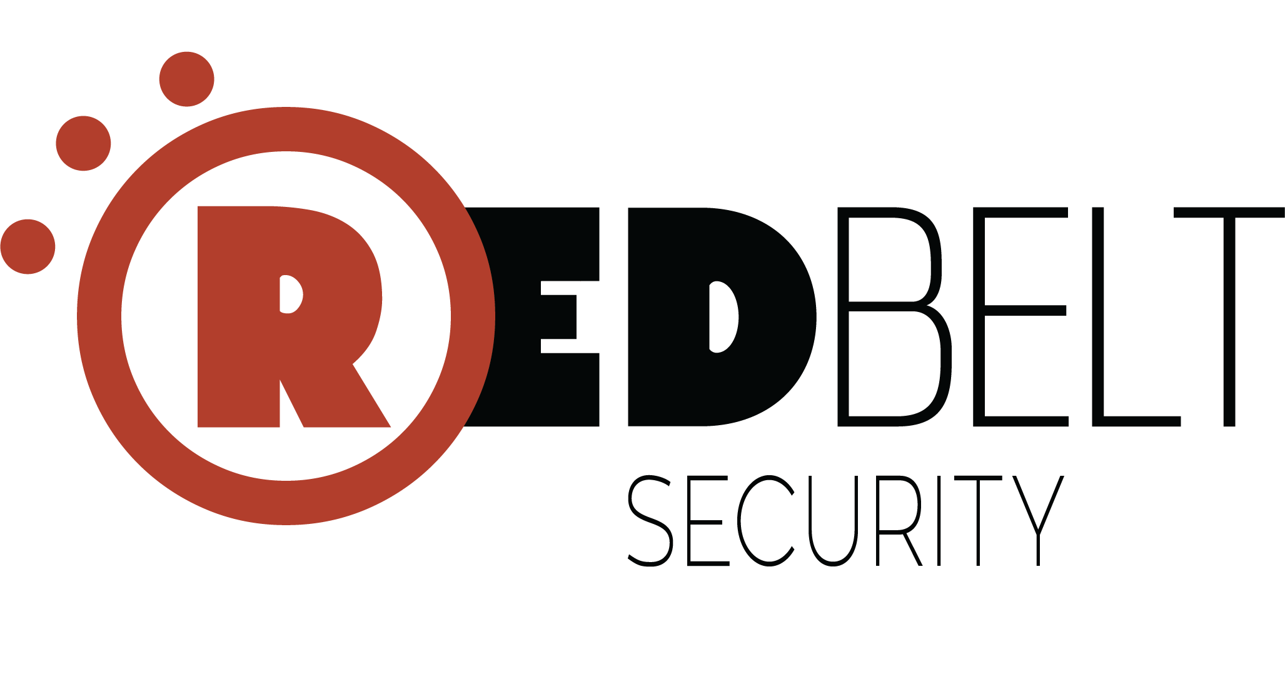

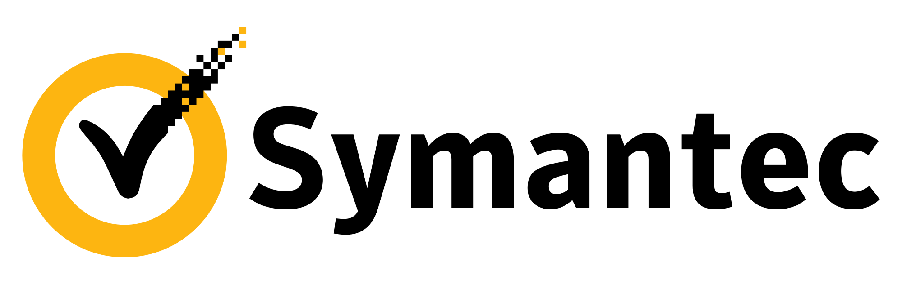





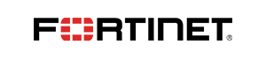

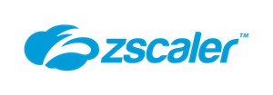
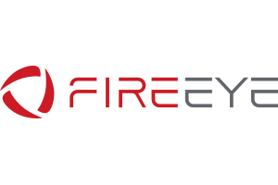

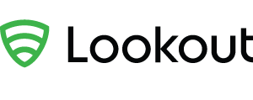

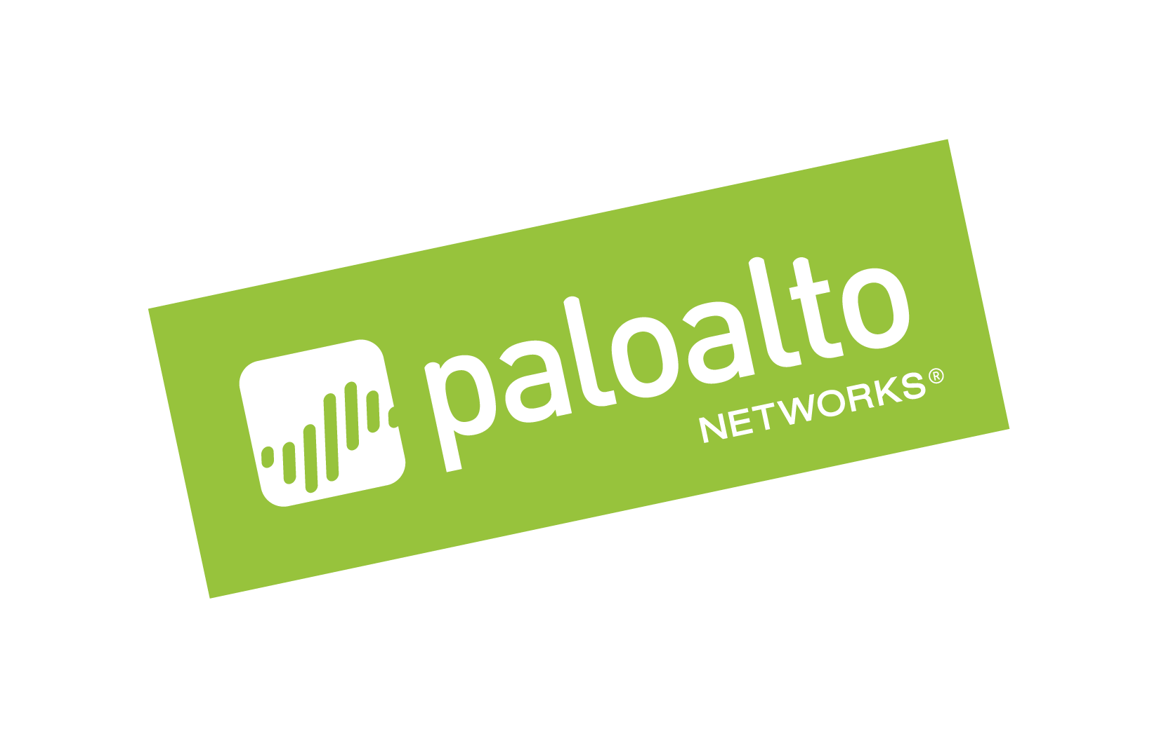
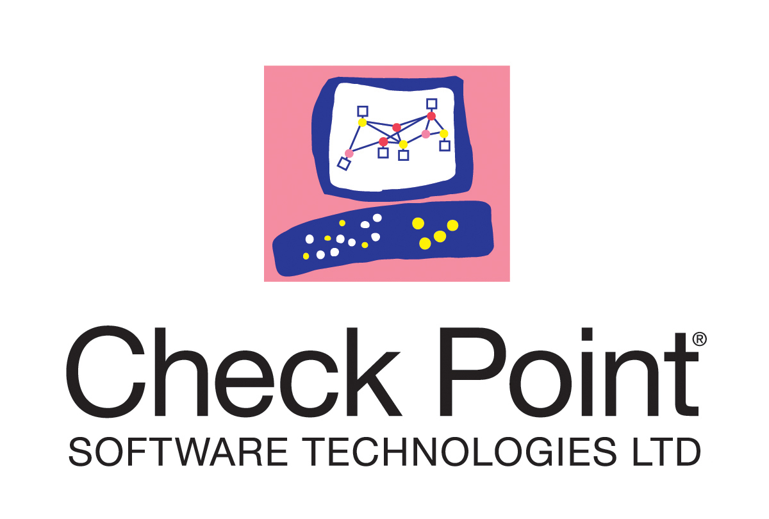
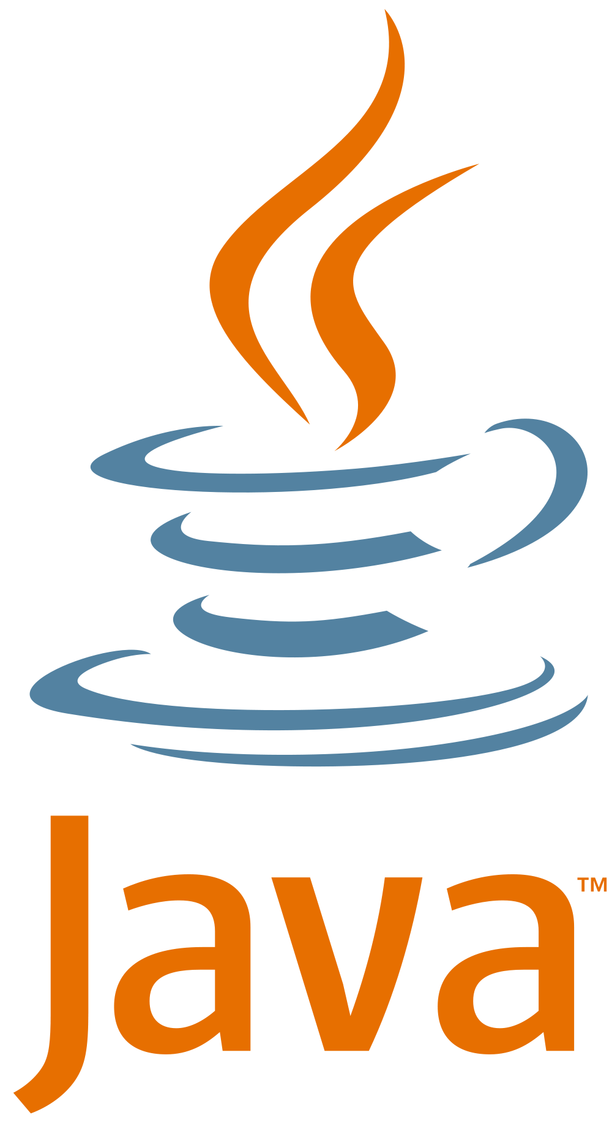

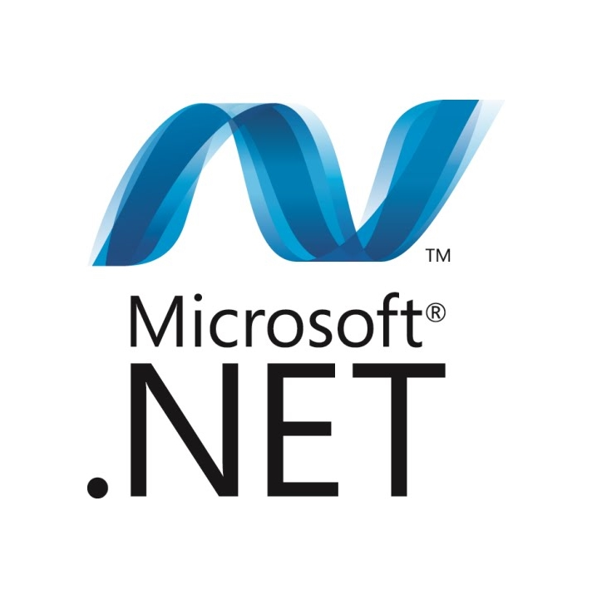



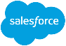

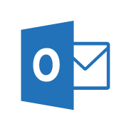
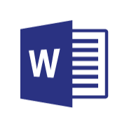
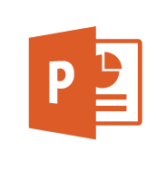
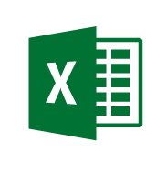
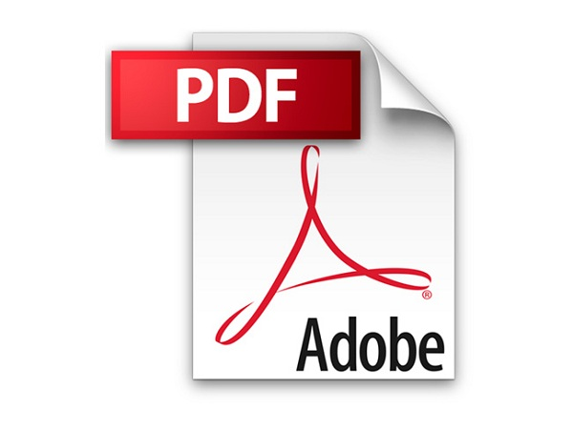


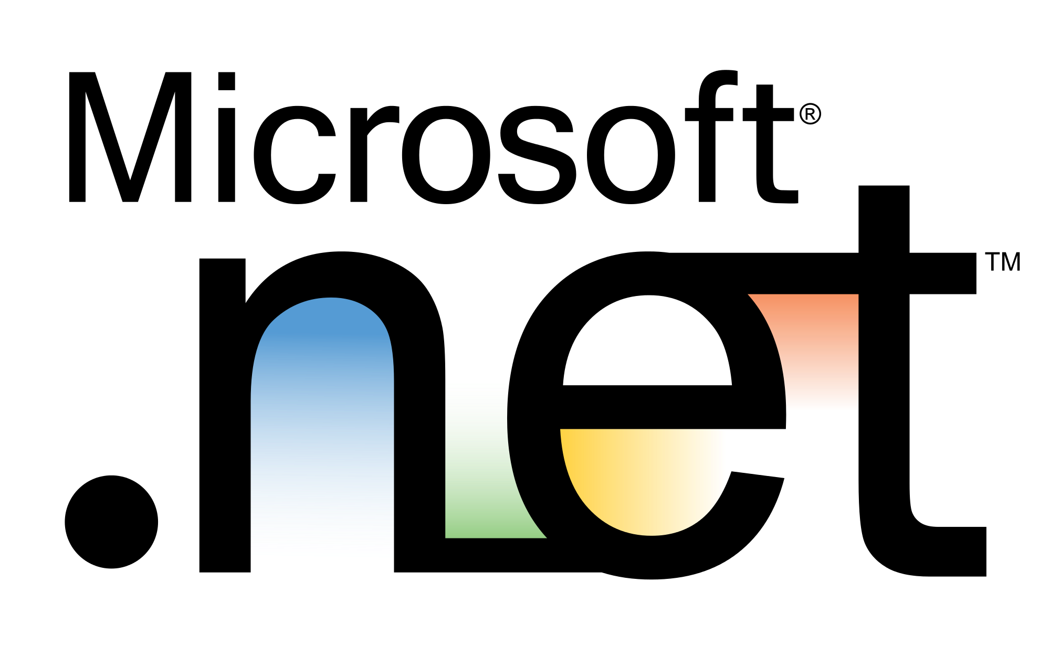
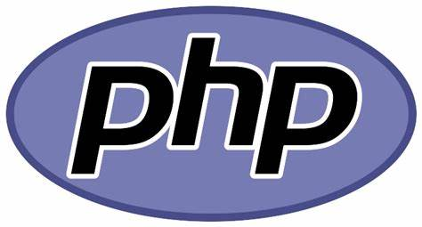
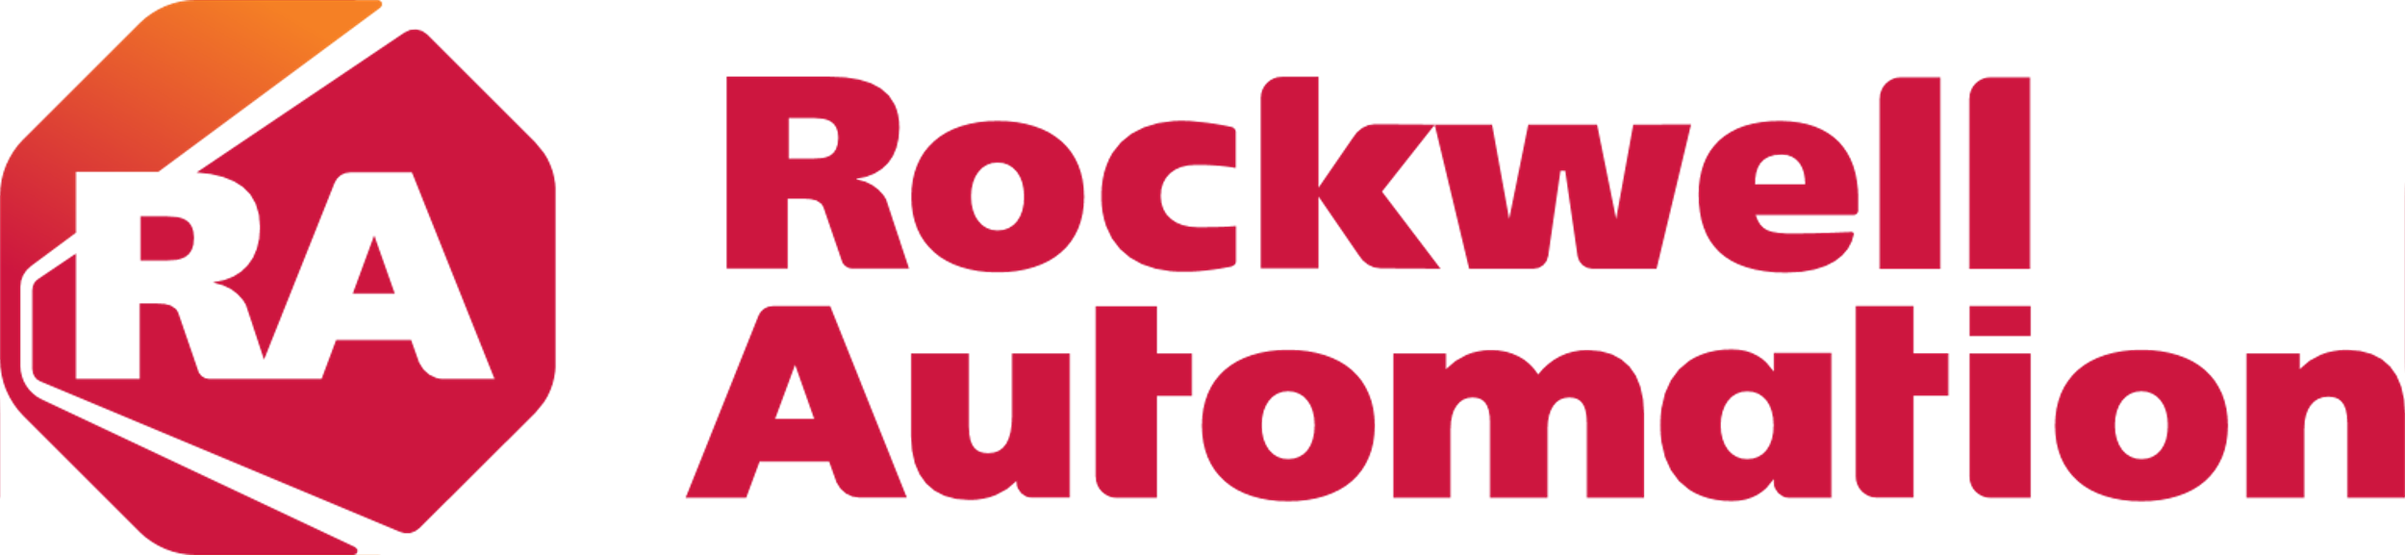
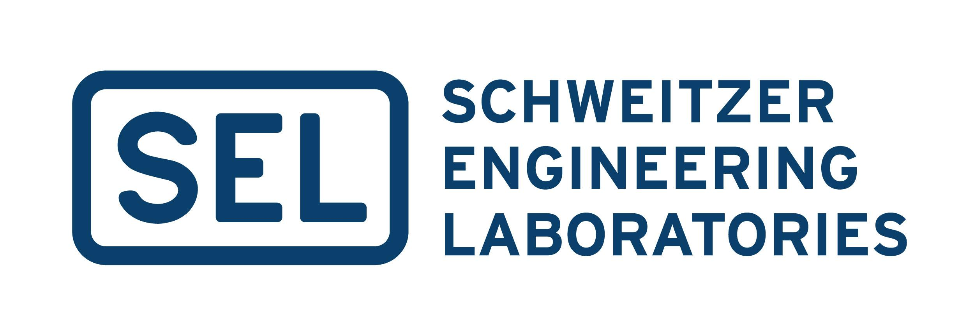
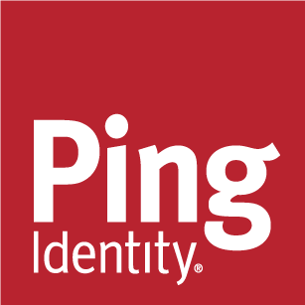
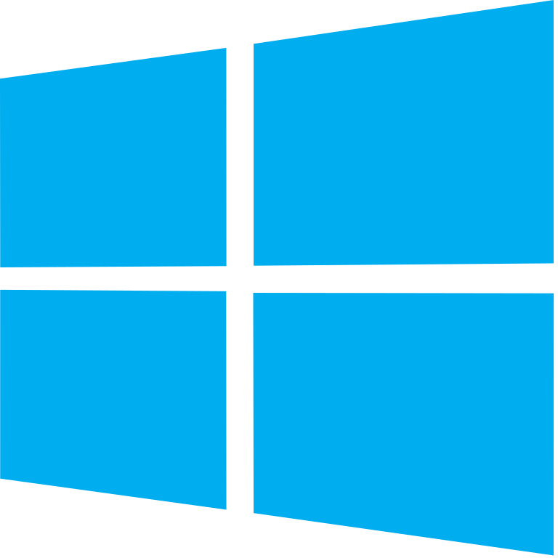



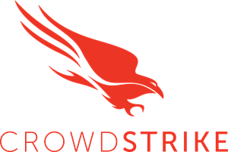

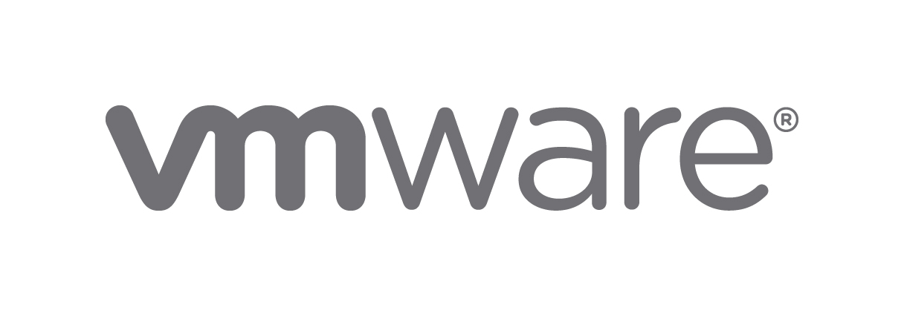

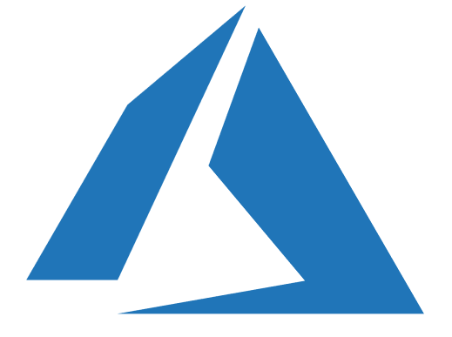

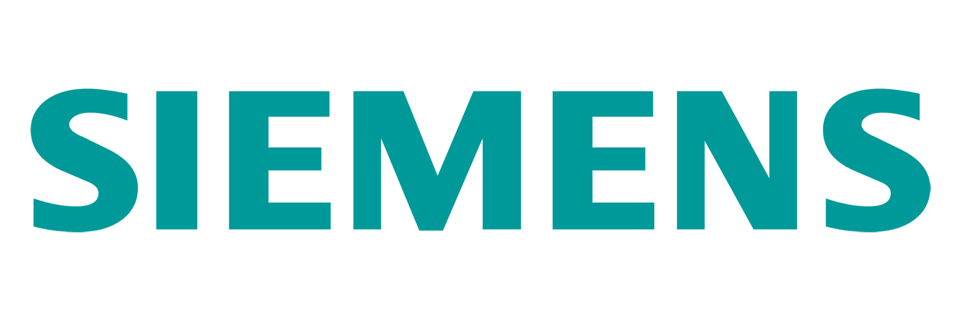

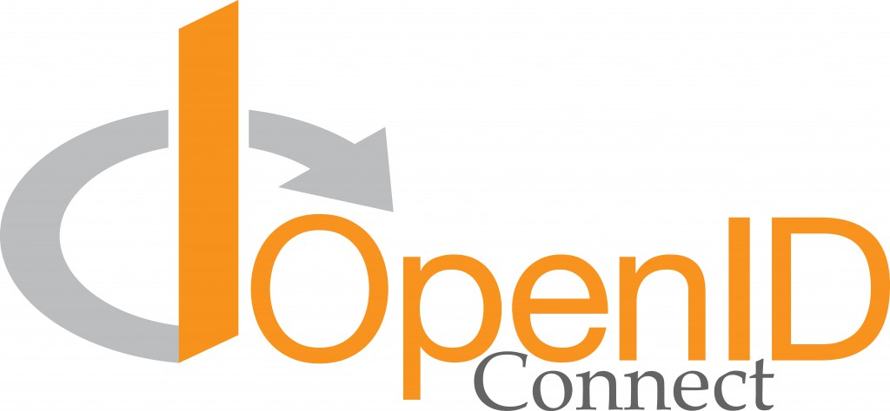


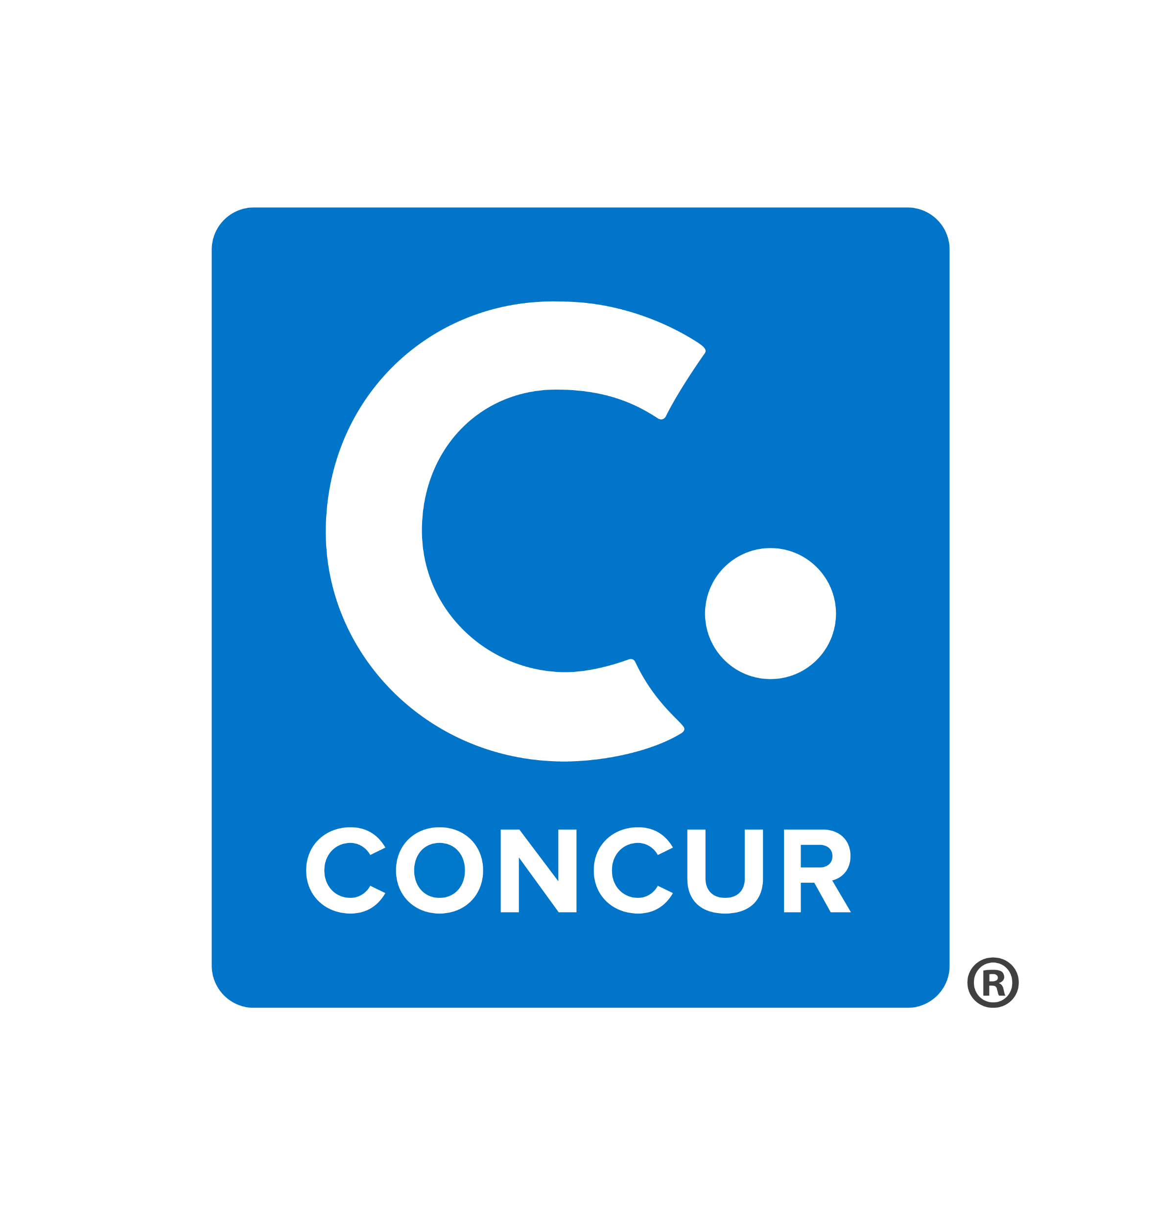
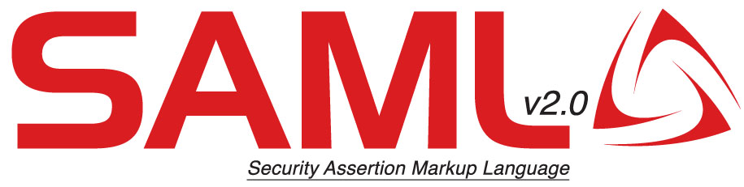
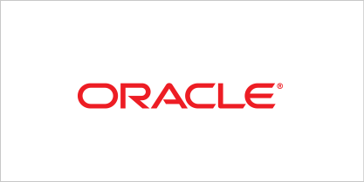
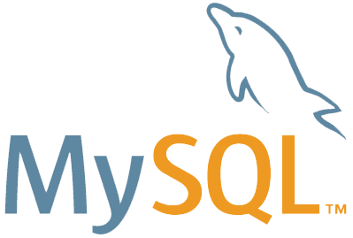





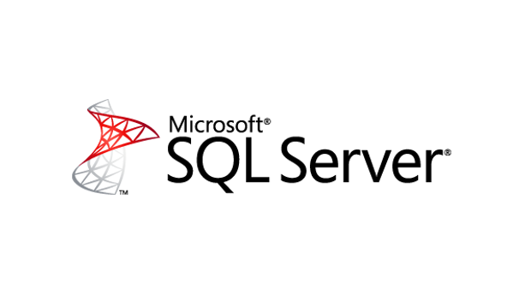

Security Operations
Legend
Outsourcing
Event Log Based Monitoring
Consulting and Escalation
Microsoft Reference Architecture
Investigation & Proactive Hunting
Native Resource Monitoring
Align to Mission + Continuously Improve
Responsiveness - Mean Time to Acknowledge (MTTA)
Effectiveness - Mean Time to Remediate (MTTR)
Broad Enterprise View
Correlated/Unified Incident View
Microsoft Sentinel
Expert Assistance
Enabling analysts with scarce skills
Machine Learning (ML) & AI
Behavioral Analytics (UEBA)
(Case Management
Security Orchestration, Automation, and Remediation (SOAR)
Analysts and Hunters
Microsoft Threat Experts
Incident Response & Recovery
Security Data Lake
Security Incident & Event Management (SIEM)
Managed Detection and Response
Using Microsoft Security
(Classic SIEM
MISA Partners
API integration
Microsoft Threat Intelligence 8+ Trillion signals per day of security context & Human Expertise
SOAR reduces analyst effort/time per incident, increasing overall SOC capacity
Deep Insights Actionable alerts from an XDR tool with deep knowledge of assets and ML/UEBA
Microsoft Defender – Extended Detection and Response (XDR)
Security & Network
SOAR - Automated investigation and response (AutoIR)
Provide actionable security alerts, raw logs, or both
Microsoft Defender for cloud
Microsoft 365 Defender
Servers & VMs
Containers
Azure app services
Network traffic
SQL
IoT & OT
Multi-Cloud
Defender for Identities
Defender for Endpoint
Defender for Office 365
Defender for Cloud Apps
Infrastructure & Apps
PaaS
OT & IoT
Identity & Access Management
Endpoint & Mobile
Modern & SaaS Applications
Information
Raw Data Security & Activity Logs
Office 365
{LDAP}
Notes:
Key Takeaway: Modern security operations is focused on managing organizational risk from active attacks (by rapidly detecting and remediating them)
While a highly technical discipline, this is also a human-centric function that empowers people with technology (rather than trying to replace people). Modern security operations technology helps extend human skills & expertise across today’s multi-cloud and hybrid environments to meet the threats posed by adaptable human attackers (and their automated tools).
Note: Cybersecurity has much in common with other forms of human conflict studied in military doctrine, fighter combat (e.g. Boyd’s OODA loop), international relations, psychology of interpersonal/group conflict, economics, and more.
Because serious cyberattacks often happen in near-real time with human attack operators, success metrics for security operations [centers] (SOCs) should focus heavily on the time attackers have in the environment and helping defenders reduce that dwell time.
While no metric is perfect, these measurement helps security operations align to organizational risk goals and drive healthy behaviors:
Effectiveness - Mean Time to Remediate (MTTR) an incident measures how long it takes to remove an active risk from the environment.
Responsiveness - Mean Time to Acknowledge (MTTA) an alert measures how long it takes before a human analyst responds to a (high-quality) detection.
Alert Quality – measuring the quality of alert feeds helps ensure that analysts don’t waste time (and effort) on false positive alerts (e.g. false alarms). Chasing false positives is both an ineffective use of analyst’s time and is also tiring/frustrating/demoralizing to analysts.
Because filtering low quality alert feeds means some legitimate detections may get ignored (along with the large amount of false positives), organizations should also implement a proactive threat hunting practice to have senior analysts search through the lower quality alert feeds to proactively hunt for undetected adversaries. This could be a part time duty of a security analyst or it could be a full-time threat hunting role (which would also search many other data sources with a hypothesis driven approach).
CLICK 1 – Classic Approach
Historically, security operations focused on collecting as much activity/event data from the environment as they could in a Security Incident & Event Management (SIEM). While collection is an important foundational step, this often led to a “collection is not detection” problem where few actionable insights were gleaned from the data collected.
Queries authored by human analysts help derive detections of malicious attacks, but these queries often generated many false positive alerts because of the static nature of the queries and the dynamic nature of attacks (and ever-increasing volume and variety of data sources). These false positives waste precious analyst time and attention and take them away from managing real incidents and attacks.
CLICK 2 – Deep Insights & Threat Intelligence
A huge leap forward for security operations effectiveness and efficiency comes from the introduction of Extended Detection and Response (XDR) tools, a trend that started with endpoint detection and response (EDR) tools like Defender for Endpoints (formerly Defender ATP)).
These XDR tools provide deep visibility into specific asset types and provide enhanced detection, response, and recovery capabilities, notably high-quality alerts that have low false positive rates. These high-quality alerts allow analysts and hunters to spend more time on mitigating real risk (the enjoyable part of the job) and less time chasing false positives and writing/maintaining queries.
XDR tools like Microsoft 365 Defender and Azure Defender provide these efficiencies by focusing on individual asset types (endpoint operating systems, identity systems, cloud productivity applications, storage services, databases, etc.) and incorporating:
Asset-specific data sources like endpoint in-memory scans and snippets of relevant network traffic on domain controllers
Deep knowledge of asset-specific attacks (pass-the-*, endpoint AV evasion, etc.)
Threat intelligence – Context derived from 8+ trillion signals per day
Machine learning (ML) and behavioral analytics (UEBA) tuned specifically to those asset types and attacks.
CLICK 3 – Automation (SOAR) and Integration
Another key element for empowering security operations comes from the adoption of Security Orchestration, Automation, and Remediation (SOAR) technologies and integration of toolsets together (natively or by providing APIs).
SOAR/Automation and Integration:
Reduce manual work for analysts and other roles with seamless experiences. Manual steps take time away from meaningful work and erode analyst morale, they would rather be fighting the bad guys than copy/pasting between tools and switching consoles
Speed Up response time because the automation happens at machine speed rather than human speed.
Increase Scale of security operations to meet the growing volume of attacks and increased scope/complexity of modern multi-cloud hybrid enterprises.
Microsoft focuses on automation and integration by
Embedding SOAR technologies throughout our tools (AutoIR in Microsoft 365 Defender, Azure Logic Apps in Microsoft Sentinel)
Single Microsoft 365 Defender console to integrate experience for endpoint, email, SaaS
Natively integrating our tools together (SIEM and XDR)
Creating APIs to connect with existing 3rd party tools
CLICK 4 – Microsoft Sentinel and SIEM Modernization
Microsoft Sentinel is a cloud-native SIEM that complements XDR tooling by providing broad visibility across XDR tools and arbitrary log/data sources from any platform, cloud, application, or device.
In addition to traditional SIEM functionality of static analysis of event logs, Microsoft Sentinel incorporates SOAR, ML, UEBA, Jupyter Notebooks, Threat Intelligence, and Security Data Lake approaches to refine threat detection, investigation, and threat hunting processes. Microsoft Sentinel also leverages Azure Data Explorer for lower cost archival of large volumes of data - https://docs.microsoft.com/azure/data-explorer/
OT/IIoT Integration – Microsoft Sentinel also includes Azure Defender for IoT integration that provides native investigation & remediation playbooks for Operational Technology (OT) and Industrial internet of things (IIoT), also known as Industrial Control Systems (ICS) / Supervisory Control and Data Acquisition (SCADA).
CLICK 5 – Expert Assistance
None of us is as smart as all of us. Succeeding against the connected ecosystem of attackers requires defenders to work together as a community; sharing intelligence, insight, and expertise.
Microsoft helps our customers get expert assistance with
Microsoft Threat Experts – Managed hunting service built into Microsoft 365 Defender that provides Security Operation Centers (SOCs) with expert level monitoring and analysis to help them ensure critical threats in your unique environments don’t get missed.
Microsoft Incident Response and Recovery Services – Microsoft's Detection and Response Team (DART) and customer support provide assistance with incident response, recovery, and hunting (onsite and remotely). This incident response is effectively "on retainer" for customers with Premier Support.
Partners / Managed Detection and Response – Microsoft partners with top experts in the industry to build their expertise on these Microsoft security operations capabilities so that they can advise and directly support our customers.
For more information on these topics, see
Mission and Metrics https://www.microsoft.com/security/blog/2019/02/21/lessons-learned-from-the-microsoft-soc-part-1-organization/
Incident Response (Investigation) - https://www.microsoft.com/security/blog/2019/12/23/ciso-series-lessons-learned-from-the-microsoft-soc-part-3b-a-day-in-the-life/
Incident Response (Remediation) https://www.microsoft.com/security/blog/2020/05/04/lessons-learned-microsoft-soc-part-3c/
Threat Hunting - https://www.microsoft.com/security/blog/2020/06/25/zen-and-the-art-of-threat-hunting/
Automated investigation and response - https://docs.microsoft.com/microsoft-365/security/mtp/mtp-autoir

Slide 18










Governance : Risk : Compliance
ANIMATED SLIDE
Microsoft Reference Architecture
Latest version: https://aka.ms/PartnerGRCArchitecture
Organizational Leadership
Board
Management
Organizational & Risk Oversight
Business Model and Vision
Organizational Risk Appetite
Value & Risk
Governance
Technology & Security Architecture
Digital Modernization
Guidance & Leadership
Asset-Centric Security
Goal Alignment
Risk Reduction
Risk Management
Least Privilege
Automation
Simple and Pervasive Security
Risk Alignment
Lifecycle Management
Explicit Trust Validation
AM I COMPLIANT ?
AM I SECURE ?

Slide 19

























Governance : Risk : Compliance
ANIMATED SLIDE
Microsoft Reference Architecture
Latest version: https://aka.ms/PartnerGRCArchitecture
Strategy & Governance Value & Risk Management
Governance, Risk & Compliance
GRC Operations
Technology & Security Architecture
AM I COMPLIANT ?
AM I SECURE ?
Discover, Assess, Report Compliance
Operational Management of Cyber Risk & Security Posture
Responsibilities
Continuous Improvement
Attack Surface Reduction
Responsibilities
Risk Assessments
Compliance Management
Supply Chain Management
Identity Governance
Information Governance
Sensitive Data Discovery
Audit and Assessment
Legal Discovery
Compliance Enforcement
Monitoring
& Hunting
Identity & Access Management
Insider Risk Management
Vulnerability Management
Information Protection
Records Management
Data Governance
Data Recovery & Destruction
Disaster Recovery
Business Continuity
Security, Risk & Compliance Operations
Responsiveness - Mean Time to Acknowledge (MTTA)
Effectiveness - Mean Time to Remediate (MTTR)
24/7 Cyber Security Detection & Response
24/7 Risk & Compliance Assessment
Microsoft’s extensive compliance capabilities
Microsoft 365 E5 Compliance
Hybrid Cloud Compliance
Microsoft 365 Defender
Microsoft Defender
Information Protection
Privacy Management
Insider Risk
Communication Compliance
Compliance Manager
Records Management
Identity Governance
Azure ARC
Azure Purview
Compliance Managemer
Automated Site Recovery
Record Mgmt
HR Systems
Information Protection
Identity Management
Modern & SaaS Applications
IaaS / PaaS / Apps / Code
Devices
OT & IoT
Physical Assets
Office 365
Notes:
May 2021 - https://aka.ms/SecurityRoles
Governance Controls:
Secure Score
Compliance Score
Data Classification
Information Governance (e5)
Records Management
Retention/Deletion Policy
Risk Mitigation:
Insider Risk Detection
Information Protection
Data Loss Prevention
Compliance (Legal):
Compliance Manager
Advanced Audit & eDiscovery
Communications Compliance
Threat Protection:
Email Encryption
Secure Collaboration
Identity Protection
Endpoint Protection

Slide 20
Defend across attack chains Insider and external threats
May 2021 – https://aka.ms/MCRA
Defender for Office 365
Defender for Endpoint
Defender for Identities
Defender for Cloud Apps
Phishing
mail
Open attachment
Brute force account or use stolen account credentials
Attacker accesses sensitive data
Exfiltration of data
Exploitation and Installation
Command and Control
Defender for Identity
Attacker collects reconnaissance & configuration data
Domain compromised
Click a URL
User account is compromised
Browse a website
Azure Defender
Attacker attempts lateral movement
Privileged account compromised
Microsoft Sentinel
EXTERNAL THREATS
Leading indicators
Insider risk management
History of violations
INSIDER RISKS
Data leakage
Distracted and careless
Disgruntled or disenchanted
Insider has access to sensitive data
Anomalous activity detected
Potential sabotage
Subject to stressors
Notes:
Key Takeaway: Microsoft provides end to end integrated visibility for the variety of attack techniques seen in both external attacks and insider risk
External Threats - Attackers are flexible and can use a variety of attack techniques during an attack chain sequence to reach their ultimate objective (most commonly stealing data, but ransomware and other extortion attackers are becoming more common).
Microsoft offers an integrated set of extended detection and response (XDR) and SIEM/SOAR capabilities that provide coverage across common attack chains. These XDR capabilities provide advanced threat detections with a focus on high quality alerts (a low rate of false alarms, aka false positives) as well as automated investigation and response capabilities. These tools are designed to work together and include:
Microsoft Defender for Office 365 (MDO) provides protection for email, SharePoint, OneDrive, Teams, and other Office 365 capabilities.
Microsoft Defender for Endpoint (MDE) provides endpoint detection and response (EDR) capabilities covering productivity workstations, servers, mobile devices, and more.
Azure Defender provides additional capabilities for Server VMs and coverage of SQL servers, containers, and more
Azure AD Identity Protection and Microsoft Defender for Identity (MDI) collectively cover the identity stages of attacks, providing detection of threats for cloud based Azure Active Directory and for on-premises based identity infrastructure based on Windows Server Active Directory and Active Directory Federation Services (ADFS).
Microsoft Cloud App Security (MCAS) provides coverage for software as a service (SaaS) apps from both an attack detection and a data exfiltration perspective.
Microsoft Sentinel provides unified visibility these tools as well as event logs and alerts from other security tools, line of business applications, network devices, and more.
Integrated Example – This is an illustration of how these tools work together to keep the organization secure and reduce the amount of repetitive tasks for analysts:
Attack - User checks personal webmail from their corporate device and opens an attachment with malware (that is designed to evade traditional AV signatures)
Detection - MDE detects this abnormal behavior and automatically investigates it, creates an automated sequence to remediate the threat, and prompts an analyst to approve the cleanup (which can also be auto-approved)
Intelligence Sharing - MDE provides information on this new malware to Microsoft Threat Intelligence systems, triggering other Microsoft security capabilities (MDE, MDO, MCAS, MDI, etc.) to search for similar malware across customers and clean it up from mailboxes, devices, cloud services, and more.
Damage Containment – Until the analyst approves the remediation, Azure AD Conditional Access blocks access to enterprise applications from this device. Once MDE communicates the “all clear” for this device, Azure AD restores user access.
Additional Remediation - Microsoft Sentinel workflows are also triggered to modify the Palo Alto Firewall to block IP addresses of the attacker’s Command and Control (C2) server.
Organizations also face insider risks where trusted insiders with access to sensitive resources may choose to abuse that access for a variety of reasons.
Microsoft Insider Risk Management in Microsoft 365 helps minimize internal risks by enabling you to detect, investigate, and act on malicious and inadvertent activities in your organization.
SIEM - Security Information and Event Management
SOAR - Security Orchestration, Automation, and Response

Slide 21

Notes:
Found this slide in an EBC deck.

Slide 22
Cloud Security Solution Categories
Category | Description | Microsoft Alignment | Additional Notes
Cloud Security Posture Management (CSPM) | Assess, detect, log, report and automate issue remediation of a cloud estate. Also focused on the discovery all assets, enforcement of security baselines, and to maintain compliance of those services. | Azure Security Center Azure Compliance Manager
Cloud Workload Protection Platform (CWPP) | Secure the workloads running across the IaaS/PaaS space including Virtual Machines, containers, Kubernetes and serverless workloads. | Microsoft Defender for Cloud
Cloud Access Security Broker (CASB) | Protection of proprietary data across your cloud environments, and prevent shadow IT. Also provides detailed review of cloud application usage. | Defender for Cloud apps
Cloud Infrastructure Entitlement Management (CIEM) & Cloud Identity Governance (CIG) | Discover identities and their entitlements. Enforce identity and access governance controls to right-size privilege access | Azure Active Directory Entitlement Management, Identity Governance, Access Reviews, Lifecycle Management

Slide 23


Slide 24
ZeroTrust for ISVs
Work in progress…
SecDevOps Technologies
Zero Trust Integration Overview
Partners Internal IT Architecture
ISV Service Build / Delivery
(Any cloud)
Microsoft Security
(Azure)
Customer Tenants
ISV Code Management
…
Securing Identities
…
Customer 1
Azure Subscription
SecDevOps
M365 / Azure
Developers
Secure Code Storage
Single Sign-On
Windows 10 PAW (Physical device)
Source Code Analysis
External Identities
Customer Identities
Hi-Trust Identity
Azure AD for IAM (Passwordless)
Anomaly Detection
Conditional Access Policies
Identity & Access Management
Continuous Access Monitoring
Access to ISV solution
Risky User/Session Detection
Key Management (Azure KeyVault)
ISV Certificate Management
…
Partner Internal IT
Corporate Tenants & Subscriptions…
Securing Access Points
…
Certificate Issuance
Fraud Protection
Corporate Security
Certificate Revocation
Secure Access Networks
FW
WAF
DDoS
Collaboration
SecDevOps
SOC Operations
ISV Hosted Services
…
ISV Developed Service Integrations
…
Company Identity
Infrastructure
Defender for Cloud
M365 Defender
Advanced Security APIs
Microsoft Sentinel
Anomali Detection
SDKs
RESTful
…
…
…
…
…

Slide 25
SOC Architecture for MSSP
MSSP People & Process
Partner SOC Architecture
Customer Tenants
SOC Team Members
Compliance (oversight)
SOC Designers
SOC Admins
Team Managers
Security Operators (L1/L2)
Threat Hunters (L3)
Incident managers
Incident responders
Incident recovery teams
Partners (B2B)
Service Management
SOC Analysts / Hunters
Implementation Tasks
Subscription / resources
RBAC + IAM
Data connectors
Built-in
Custom
Syslog collector
Data enrichment
Threat Intel feeds
Analytics and ML
Playbooks (automation)
Product integration (2-way)
Security data warehouse
SOC Internal Management Tasks
Access management (RBAC)
M365 administration tasks
Customer tenant health checks
Customer reporting (threats, SLAs)
Training and development
Insider Risk Management (watching the watchers)
Manage DevOps pipelines
….
SOC Custom Focused Tasks
Alert monitoring and tuning
Proactive threat hunting
Red/Blue Team Exercises
Continuous pen-testing
Risk analysis (strategic/tactical)
Implement/improve protections (consulting)
Incident response & recovery
Customer training
…
Operating Costs
Salary and compensation
Facilities
Equipment
Secure Access Workstation
Authn Tokens
Service subscriptions:
M365 E5
Azure Subscriptions
ServiceNOW
SOC Architecture
Product Owner
Maintenance Tasks
Data retention
Connector health
Cost management
Access management
SOC Platform Development Tasks
Efficient customer onboarding
Use case development
Workbook development
Tune signal to noise ratio
Integrations and automation
Analytics and ML
Enhanced Threat Intelligence
Vulnerability, risk, threat reporting
Secure customer communications
Secure access to all tenants
Evidence retention for forensic analysis and chain of custody
Product Management
Microsoft partnership
Billing and revenue
Training
Impact analysis
Solution partners
Marketing & sales enablement
Market / compete analysis
Service review / improvement
Recruit and retain
Career development
Budget management (ROI)
…
Customer Contacts
Executive sponsor
Risk & Compliance
Security personnel
Dev/IT Teams
Operational Technology
Helpdesk (escalation)
Employees
IT Service Partners
Business Partners
Revenue Generation
Microsoft partner credits
Customer billable services
Consulting
Management
Monitoring & Alerting
Incident response
Intellectual property

Slide 26
MSSP Profitability
Azure Reference Architecture
Partner
Customer
MSSP Operations
Azure Subscription 0
Customer 1
Azure Subscription 1
Partner Profit
The partner profitability is based on the services provide: skills, expertise, 24*7 operations, consulting hours, and intellectual property provided/developed.
There are several ways to scope the value of the partner services:
Reducing their staffing requirement: how much work is the partner doing on behalf of the customer
Rapid enablement: the partner may deploy new capabilities faster than the customer team may do on their own
Ongoing improvements: the partner can add value by continuously improving the security readiness of the customer
PAL / CSP Registration
Microsoft pays the partner based on % of total spend in this subscription
EA: Partner Admin Center
CSP: Partner Portal
Customer 2
Azure Subscription 2
PAL / CSP Registration
Microsoft pays the partner based on % of total spend in this subscription
Microsoft Credits:
Microsoft security solutions are deployed within the Customer tenant, there are two options from a billing perspective:
EA: Customer transacts with Microsoft (LSP) and pays the partner only for their managed security services. Partner may be qualified to be paid by Microsoft based on monthly Azure consumed revenue for all applicable workloads within the subscription: PAL
CSP: Billing for the tenant is provided via the partner. Microsoft pays the partner credit and rebate based on monthly Azure consumed revenue for all applicable workloads within the subscription: CSP
We recommend a new Azure subscription is created for each security deployment, instead of using the customer's existing production workload subscription(s).
Customer 3
Azure Subscription 3
PAL / CSP
Registration
Microsoft pays the partner based on % of total spend in this subscription
Notes:
This slide is for partner guidance only. It covers the two key ways they will gain profit from running an MSSP on the Microsoft Azure security solutions. CPOR is not included here as it is focused on M365 tenants.

Slide 27
Microsoft Sentinel for Cross-Cloud Deployment
Separating your sensitive security data
GCC-High
Azure Subscription 2
Syslog
Regulated Data
On-premises
Logic Apps
Regulated Data
Azure Subscriptions
Microsoft Sentinel
Global SOC Operations
Azure Subscription 1
CA
Regulated Data
Office 365
Log Analytics
B2B
Customer Identity
Azure AD: Tenant 3
Regulated Data
Other Cloud Services
SOC Identity
Azure AD: Tenant 2
Commercial Cloud
Azure Subscription 3
Syslog
Customer Data
On-premises
Logic Apps
Microsoft Sentinel
Customer Data
Azure Subscriptions
CA
Log Analytics
Customer Data
Office 365
B2B
Customer Identity
Azure AD: Tenant 4
Customer Data
Other Cloud Services
Notes:
Two key points to articulate here:
Can collect data from any source including:
Azure / Office 365
Any IaaS/PaaS/SaaS solution
On-premises (hybrid cloud)
Data ALWAYS goes into the customers tenant, never into the MSSP tenant

Slide 28
MDE for MSSP
Partner
Customer
Reference Architecture
MSSP Operations
Azure Subscription
Customer 1
Azure Subscription
Customer 1
M365 Subscription
Partner Admin Center
PAL Registration
Microsoft Defender
SOC Collaboration
M365 Subscription
Azure Lighthouse
B2B
Groups
Delegated Access
Teams for secure collaboration and communication
Microsoft Sentinel API
EM
Customer Identity
Azure AD: Tenant 3
Cross Workspace Incident View
CA
Customer 2
Customer 3
PIM
Customer 4
MSSP Identity
Azure AD: Tenant 2
Notes:
This view helps to articulate the difference for MDATP and other security solutions that will require additional permission controls:
MDATP defines RBAC permissions based on groups in Azure AD. If the SOC analyst needs delegated access to carry out hunting and remediation activities, they will need to be a member of the appropriate groups
AAD Entitlement Management (EM) provides a mechanism for automating the provision and deprovision of B2B guests and their permissions. See this blog post for more details: https://techcommunity.microsoft.com/t5/microsoft-defender-atp/multi-tenant-access-for-managed-security-service-providers/ba-p/1533440

Slide 29
Azure FW for MSSP
Partner
Customer
Reference Architecture
MSSP Operations
Azure Subscription
Customer 1
Azure Subscription 1
Customer 1
Subscription 2
Partner Admin Center
PAL Registration
Azure FW
SOC Collaboration
M365 Subscription
Multi Tenant Support ?
Azure FW Manager
Customer 1
Subscription 3
Teams for secure collaboration and communication
Azure FW
B2B
Customer Identity
Azure AD: Tenant 3
CA
Customer 2
Customer 3
PIM
Customer 4
MSSP Identity
Azure AD: Tenant 2

Slide 30
Azure Roles & Permissions Overview
Reference Architecture
Partner
Customer
MSSP Operations
Azure Subscription 1
Customer 1
Azure Subscription 2
Gain partner earned credit for services
CSP License Model
CSP Admin
For CSP subscription enrollment only: Automatically provides roles for administration
Partner Admin Center
PAL Registration
For non-CSP subscriptions: Customer can designate partner administration roles
Azure Lighthouse
Azure Permissions
Contributor or Read Only access to Log Analytics Workspace
Microsoft Sentinel
Cross Workspace Incident View
M365 Roles
Azure AD Groups
Azure AD Roles
Log Analytics
B2B + CA
Customer 2
PIM + EM
Customer Identity
Azure AD: Tenant 3
PIM
Customer 3
Delegated Access
Customer 4
Internal Access
MSSP Identity
Azure AD: Tenant 2
Notes:
This advice changes if the customer decides to use an EA model subscription instead of a CSP based subscription.
Read here to learn more about CPoR: https://docs.microsoft.com/en-us/partner-center/submit-osa-claim
Also note: the pricing for Microsoft Sentinel is discounted by 15% for a CSP subscription (partner choice on actual cost to customer). The customer may get a better price for Microsoft Sentinel through their EA agreement
List of links embedded on this page:
CSP Model Overview: https://docs.microsoft.com/en-us/partner-center/csp-overview
Partner Admin Center: https://docs.microsoft.com/en-us/partner-center/pac-to-pc-overview
Partner Earned Credit: https://docs.microsoft.com/en-us/partner-center/partner-earned-credit
Compare Azure Offers: https://docs.microsoft.com/en-us/partner-center/compare-azure-offers
CSP Permissions Overview: https://docs.microsoft.com/en-us/partner-center/permissions-overview

Slide 31
Microsoft Sentinel Reference Architecture Global SOC Model: Multi-SIEM
Subscription 1
Global SOC View
Subscription n+1
Individual Instances
Subscription 2
…
Subscription 2
…
Subscription 2
…
Logic Apps
Subscription 2
…
Global SOC Operations
Logic Apps
Azure AD Logs
Microsoft Sentinel
Microsoft Sentinel
Central Management
Cloud Apps
Log Analytics
Log Analytics
Dashboards
IaaS / PaaS
App Logs
Ticketing
Splunk Console
Splunk
On-premises Logs

Slide 32
Microsoft Sentinel Reference Architecture Global SOC Model: Access to Regional SOC Teams
Subscription 1
Region 1 SOC View
Subscription n+1
Individual Instances
Subscription 2
…
Azure AD Logs
Subscription 2
…
Subscription 2
…
Cloud Apps
Logic Apps
Subscription 2
…
Logic Apps
Microsoft Sentinel
Microsoft Sentinel
IaaS / PaaS
Global SOC Operations
Log Analytics
Log Analytics
App Logs
Central Management
On-premises Logs
Dashboards
Ticketing
Subscription 2
Region 2 SOC View
Subscription n+1
Individual Instances
Subscription 2
…
Azure AD Logs
Subscription 2
…
Subscription 2
…
Cloud Apps
Logic Apps
Subscription 2
…
Logic Apps
Microsoft Sentinel
Microsoft Sentinel
IaaS / PaaS
Log Analytics
Log Analytics
App Logs
On-premises Logs

Slide 33
Which Console Do I Use ?
Portal Navigation
Security Operations & MSSP Tools
Initial Monitoring Tools for Breadth Investigation
Investigation and Response for Depth Investigation
High level view across all IT, OT, Security, and Compliance
Security Operations central console for proactive and reactive threat response
Expert solutions for deep analysis and configuration
Portal.Azure.Com
Security.Microsoft.com
Custom TDR Platform
Full Control
Microsoft Sentinel Portal
Single Workspace
Microsoft 365 Defender
Endpoint
MIP
MEM
Central Management
Cross-workspace Incident View
Dashboards
Portal.Azure.Com
Azure Lighthouse
Multiple Workspaces
Microsoft Defender
Azure AD
Ticketing
Restricted View/Actions
OT / IoT
Azure Firewall Manager
Workbooks
Reporting
PowerBI
External Sources
3rd Party Tools
CI/CD Pipeline
Networking
Containers
Full Control
Azure Data Explorer
Historic and Extended Data
AI / ML
CI / CD Pipeline
Notes:
This slide does need some additional information, however it is useful to articulate the following:
When configuring the Microsoft Sentinel implementation you need to have direct access to the subscription, either manual, scripted, or automated deployment is possible
Ongoing operations can be carried out with restricted views and different interfaces:
Azure Lighthouse for permissions management (may also need to include AAD B2B with CA/PIM/EM)
Cross-workspace incident view for centralized threat hunting across workspaces
Workbooks curated to filter the view based on requirements (restrict access based on role/region etc)
PowerBI for more advanced reporting options than may be possible with Workbooks alone
Note:
Table level RBAC (lets put a side lighthouse) works well when consuming LA data from workbook, the LA query windows and even ruining playbooks for the given data.
Table level RBAC doesn’t work well when entering sentinel UI (opening main overview page\incident blade )- meaning that when we build the product, we design it for persona that have full access to the data
3. Once an incident is triggered and investigated on the left, the operator can pivot to the tools on the right

Slide 34
Microsoft 365 Lighthouse
How it works
Announcements: https://techcommunity.microsoft.com/t5/small-and-medium-business-blog/announcing-microsoft-365-lighthouse-for-managed-service/ba-p/1698181
Also see Microsoft 365 All Tenants list: https://techcommunity.microsoft.com/t5/microsoft-365-blog/microsoft-365-all-tenants-list-is-rolling-out/ba-p/1749967

Slide 35
Microsoft Sentinel Long term retention options Please review this slide deck for a more in-depth look at this topic, created by Younes Khaldi
Microsoft Internal Use and Microsoft Partners Only

Slide 36
Advanced Data Management
New guidance from Javier:
https://techcommunity.microsoft.com/t5/azure-sentinel/using-azure-data-explorer-for-long-term-retention-of-azure/ba-p/1883947
Data Management and Alternative Analysis
Azure Storage
Microsoft Sentinel
Azure Blob Storage
Azure Log Analytics
Unstructured file system
Query using KQL (in Microsoft Sentinel)
Azure Event Grid
Azure EventHub
Listens to Azure Storage, updates Azure Data Explorer to pull new data
Transfers data from other services into Azure Data Explorer
Azure Log Analytics
Azure Storage
Log Analytics Workspace
Azure Data Lake Storage
Centralized storage for solution-based analysis
Query using KQL (in Microsoft Sentinel)
HDFS structured file system
Petabyte scale, throughput for hundreds of Gigabytes
Query using Hadoop and Data Science techniques
Azure Data Explorer
Data Exploration & Presentation
Collect, store, and analyze data
Ideal for large volumes of diverse data
Used for diagnostics, monitoring, reporting and machine learning
Cosmos DB
…
…
Ingest Pipeline
Azure Data Factory
Control Flow
Data Integration & Transformation Service
Fully managed integration service
Data driven workflows for orchestration and automation of data movement and transformation
Transforms and enriches data for insights
Can be one-time, periodic, or event triggered
Can copy data from one store to another
Data Flow
Other Connectors
Azure IoT Hub
Schedule
Logstash plugin
Kafka connector
Power Automate
Apache Spark connector
Transfers data from supported IoT devices into Azure Data Explorer
Monitor
Tags
Azure Functions
Notes:
New Reference Architecture is here: https://docs.microsoft.com/en-us/azure/architecture/solution-ideas/articles/monitor-azure-data-explorer
Querying data in ADX
https://docs.microsoft.com/en-us/azure/azure-monitor/logs/azure-monitor-data-explorer-proxy
Discussion points:
Before the data arrives in Log Analytics, some companies may need to modify the data for tagging and other types of enrichment
The data may be part of a larger data set that is shared across the organization and needs to be made available to other teams outside of security
Consideration also need to be given to the long-term retention and potential of additional analysis for the data when it is not longer required in Microsoft Sentinel

Slide 37
Advanced Data Management
Data Management and Alternative Analysis
Microsoft Sentinel
Use Data Export + Event Hub
A list of supported tables here
Configure Data Export here
Full documentation on this feature here
Azure Log Analytics
Supported Tables
Azure Log Analytics
Log Analytics Workspace
Use Logic App to query Log Analytics and copy to EventHub.
Here the main issue are the logic app connector limits, which are documented here
Centralized storage for solution-based analysis
Query using KQL (in Microsoft Sentinel)
Azure Data Explorer
Unsupported Tables
Build an Azure Function that does the same as the Logic App.
In this case, still most of the limits from the previous one apply
Data Exploration & Presentation
Collect, store, and analyze data
Ideal for large volumes of diverse data
Used for diagnostics, monitoring, reporting and machine learning
Use the logic app by Matthew Lowe to send to storage
Then use an external table in ADX to query the data
Still, the same logic app connector limits apply
Original Log Source(s)
Send directly from the source to event hub.
In the case of some sources like the ones based on diagnostics settings, you can send directly to EH (also when using logstash).
Notes:
Querying data in ADX
https://docs.microsoft.com/en-us/azure/azure-monitor/logs/azure-monitor-data-explorer-proxy
ADX Pricing Calculator: https://dataexplorer.azure.com/AzureDataExplorerCostEstimator.html

Slide 38

Advanced Log Management (Preview)
Details in these screenshots are not final, team is looking for feedback before final release
(see Pablo Chacón and Julian Gonzalez)
https://aka.ms/SearchRestoreArchPreview
Long term storage for Microsoft Sentinel data
This is still a viable option, but separate infrastructure, engineering effort, and pricing:
Azure Data Explorer
Data Exploration & Presentation
Collect, store, and analyze data
Ideal for large volumes of diverse data
Used for diagnostics, monitoring, reporting and machine learning

Slide 39
Centralizing Audit Logs
10-year retention of all audit logs
Centralized Visibility and Reporting Capabilities
NA
LATAM
EMEA
APAC
Others…
Hunting
Use Cases
Hunting
Use Cases
Hunting
Use Cases
Hunting
Use Cases
Hunting
Use Cases
ADX
Sentinel
ADX
Sentinel
ADX
Sentinel
ADX
Sentinel
ADX
Sentinel
Secure Transfer Any Data – Distributed and Isolated in Region
EMEA
LATAM
APAC
NA
Others..
Globally Distributed Company with complex regulatory requirements

Slide 40
Microsoft Security Architecture Data Management Deep dive deck here: Log Collection Challenges and Solutions-V1.1.pptx Created by Yaniv Shasha and Edi Lahav
Microsoft Internal Use and Microsoft Partners Only

Slide 41


Microsoft Security Reference Architecture
Security Architecture Components
Retention/Compliance
Security Data Warehouse
Network Security
Network Security Solutions
Health/Trend Analysis
CSPM/CWPP Solution
Database Security
Log Analysis
Container Security
IaaS / PaaS Services
Storage Protection
Active Threat hunting
Server Protection
Servers
SIEM Solution
XDR
Platform
CASB Solution
SaaS Apps
Incident Management
Identity Protection
Identity & Access Management
SOAR
Information Protection
ITSM
Endpoint Protection
Clients
CSM
Reporting
Centralized Logging & Control
Expert “Edge” Solutions
Log Sources
Notes:
Microsoft solution names removed to ensure clarity of the discussion without the conversation heading towards “only Microsoft”
Key discussion points:
The GREY boxes are the log sources across a range of solutions and endpoints. This list should be expanded to include any other categories that are regularly used and should also form the basis of an assessment the customer/partner can use to ensure all relevant and valuable data/log sources are made available to the security architecture
The GREEN boxes are the solutions that make up the standard SIEM implementation – the focus here is on the storage of log data either to SIEM first, then Long Term Storage, or have data duplicated from point of collection directly to both (saves moving data later on when the 90 days expires)
The BLUE boxes are the modern security solutions being deployed (aka XDR, MDR, EDR etc) that are already ingesting the raw log data, analyzing it for risks and threats, and even carrying out direct response to threats (even before the log is ingested by the SIEM). There are several key question here
If the logs were only sent to the blue box, and then alerts were sent to the SIEM, would this be enough for the SIEM to act appropriately by collating alerts from multiple systems (and analyzing logs from those sources that do not have a smart option)
If these solutions are doing this analysis, what additional value would there be in the SIEM also carrying out that analysis
What are the capabilities that are lost if the implementation is such that not all raw logs are sent to the SIEM
If an EDR on an endpoint is a strong standalone solution, why not EDR on a server ?
From a cost-savings perspective, can we support a deployment like this? Here is an example:
Customer has 6TB of data being ingested per day (approx. $6M per year):
2 TB from Server endpoints
2 TB from Client endpoints
2 TB from network and other security products
Customer decides to invest in ASC with MDATP to monitor their server estate
This reduces their SIEM costs by $2M
That $2M is invested in ASC with MDATP
Isn’t this a better security architecture ? (only IF the alerts sent from ASC are rich enough for the SIEM to act upon)

Slide 42

Microsoft Sentinel Reference Architecture
Governing data flow to reduce costs and maximize detection capability
For the SIEM, the focus should be on threat hunting across multiple smart solutions and raw log files that aren’t protected by a smart solution. All data that is ingested should be analyzed for threats.
Recommend a regular review of data that is not analyzed and move to long term storage instead to reduce overall costs of the SIEM implementation.
Smart solutions are deployed to detect and respond at the edge. Do not attempt to repeat this capability in the SIEM, use these solutions to their full capability and send only the alerts to the SIEM. Cross solution investigations need to be engineered to reduce effort by the SOC Analyst
There is the potential for huge volumes of data available from all the devices and solutions deployed in the customer environment and cloud.
Recommend mapping these sources and ensuring appropriate filtering to reduce volume of ingested data in SIEM
Health and Performance Monitoring
Centralized log collection and analysis
Expert Solutions
Long Term Storage / Trend Analysis
Azure Monitor
Data Ingestion
CSPM / CWPP Platforms
Azure Data Explorer
Alert monitoring, threat hunting, and incident response/coordination
XDR Platforms
Log Analytics
(Data Lake)
Alerts Only
Specialist / Point Solutions
ServiceNOW
Microsoft Sentinel (SIEM / SOAR)
Long Term Storage
Real Time Threat Analysis
Product Specific Threat Protection
Extended Threat Hunting
Data Collection, Normalization, Cross-Correlation
Product Specific Threat Protection
Microsoft Security Best Practices: https://docs.microsoft.com/en-us/security/compass/microsoft-security-compass-introduction
Notes:
Microsoft Security Best Practices: https://docs.microsoft.com/en-us/security/compass/microsoft-security-compass-introduction
Review for information about what are useful feeds.

Slide 43






Log Management : Client & Server Endpoints
Limitless Microsoft Defender for Endpoint Advanced Hunting with Azure Data Explorer (ADX)
Data Management Options and Discussion Points
THREAT HUNTING:
To reduce risk of compromise we need to proactively protect from threats, find and resolve vulnerabilities, hunt for anomalies, and investigate alerts and respond to incidents.
To achieve this on Client Endpoints we deploy an Endpoint Detection & Response solution that provides multiple techniques for visibility, protection, and automated response.
Alerts will be sent to the SIEM to ensure coordinated respond and correlation to events discovered in other security solutions such as Identity and Firewalls
Optionally, the full enriched data from the EDR can be transferred directly to the SIEM solution to enable additional threat hunting, cross analysis, applied threat intelligence, and advance machine learning algorithms.
The data can also be sent to the security data warehouse for long term data retentions. This could occur at the same time as sending to the SIEM, or it can be sent there after the SIEM has expired the data.
COST MANAGEMENT:
At minimum the EDR Alerts should be sent to the SIEM solution to ensure correlation across activities and threat detections from other security solutions.
The enriched data should also be retained for at least 1 year, maybe longer depending on specific business and regulatory requirements. There are two options to achieve this:
Ingest the data directly to the SIEM: has the highest cost and provides the greatest threat hunting capabilities.
Ingest the data into the Security Data Warehouse instead: this is a lower cost option
Collecting raw log data should only be considered when documented use case scenarios require the collection of specific events and changes on client endpoints.
Retention: Unlimited
Everything Else
Security Data Warehouse
SIEM Connector, WEF Collector or Syslog Server
Filtered Telemetry
Query data in-place
Performance Logs
SIEM Solution
(TI / ML / UBA)
API Integration or SIEM Connector
EDR Enriched Data
XDR Platform
(EDR Service)
Advanced hunting telemetry, TVM data, logon / network / file / registry events, AV/Anti-Malware
Server/Client Endpoints
Application Logs
Alerts Only
Security Logs
Retention: xMonths
Retention: Days/Weeks
Operating System
Query data in-place
Centralized Logging & Control
Expert “Edge” Solutions
Log Sources
Notes:
Microsoft Sentinel FAQ for free ingestion: Microsoft Sentinel Pricing | Microsoft Azure
New blog post here about doing this with MDE: Limitless Microsoft Defender for Endpoint Advanced Hunting with Azure Data Explorer (ADX)

Slide 44
Log Management : Client & Server Endpoints
Data Management Options and Discussion Points
This diagram is intended to invoke a conversation about WHAT data is needed WHERE.
The key considerations to keep in mind whilst having this conversation are:
Capability: does the Security team have the data and tools they need?
Affordability: can you justify the cost of the security architecture to achieve the results?
CWPP
Hybrid Infrastructure
CSPM
IaaS/PaaS Services
CASB
SaaS Platforms
Optional: SIEM Bypass
Other security solutions…
Collaboration
Office 365
IAM
AD / Azure AD
Security Data Warehouse
SIEM Solution
(TI / ML / UBA)
API Integration or SIEM Connector
Enriched Data
XDR Platform
Performance Logs
EDR
Server/Client Endpoints
Application Logs
Retention: Unlimited
Retention: Months/Years
Alerts Only
Retention: Days/Weeks
Security Logs
Operating System
Extended Threat Hunting:
The SIEM is used to correlate the information from the XDR platform with data feeds and alerts generated by other security solutions. The SIEM is the first step in analyzing all available data and alerts before going to the Advanced Threat Hunting platforms (such as XDR) or Extended Threat Hunting using the Security Data Warehouse.
Note: if the data does not exist in the SIEM, then analytics rules can not detect advanced threats
Advanced Threat Hunting:
The XDR platform provides log collection, correlation, analysis, and advanced threat hunting capabilities within this platform
SOC analysts should utilize this functionality as part of their proactive and reactive security operations. Visibility is limited to those resource in scope, other tools may be required to extend threat hunting (use the SIEM or other threat detection platforms).
RAW Log Data:
Most network connected devices and services will provide some level of event logging that can be extracted and analyzed for potential exploits and active threats.
If the log data is not extracted there is a risk of loss during/after an attack. Collecting logs enables forensic analysis post-breach, even if the device is wiped
Centralized Logging & Control
Expert “Edge” Solutions
Log Sources
Notes:
Javiers article on using Azure Data Explorer:
https://techcommunity.microsoft.com/t5/azure-sentinel/using-azure-data-explorer-for-long-term-retention-of-azure/ba-p/1883947

Slide 45
Log Management : Client & Server Endpoints
Data Management Options and Discussion Points
In this diagram we are looking at the identity integration from the perspective of the Security Partner SOC view into a customer.
Security Partner SOC View
Azure AD
Azure AD B2B
Microsoft Sentinel
(MSSP)
Hybrid Infrastructure
Microsoft Defender
IaaS/PaaS Services
Defender for
Cloud Apps
SaaS Platforms
Azure Lighthouse
Defender for Office
Office 365
Defender for Identity
AD / Azure AD
Azure Data Explorer
Microsoft Sentinel (Customer)
Enriched Data
Security. Microsoft.com
Performance Logs
Defender for Endpoint
Server/Client Endpoints
Application Logs
Retention: Unlimited
Retention: 3-24 Months
Alerts Only
Retention: 30 Days
Security Logs
Operating System
Centralized Logging & Control
Expert “Edge” Solutions
Log Sources

Slide 46
Log Management : Client & Server Endpoints
Data Management Options and Discussion Points
In this diagram we are looking at the data connectivity from the perspective of the Security Partner SOC view into a customer.
Microsoft XDR:
Azure Defender should be configured to use the same Log Analytics workspace as Microsoft Sentinel, this enables full search capability at discounted storage costs
Security Partner SOC View
Azure AD
Microsoft Sentinel
(MSSP)
Microsoft XDR:
Data stored in the XDR platform can be queried via API…
Microsoft Sentinel based Threat Hunting:
The partner can create remote queries that run against multiple customer Microsoft Sentinel workspaces. These queries can also run against Azure Data Explorer.
Microsoft Defender
Hybrid Infrastructure
IaaS/PaaS Services
Defender for Cloud Apps
SaaS Platforms
Defender for Office
Office 365
Defender for Identity
AD / Azure AD
Azure Data Explorer
Microsoft Sentinel (Customer)
Enriched Data
Security. Microsoft.com
Performance Logs
Defender for Endpoint
Server/Client Endpoints
Application Logs
Retention: Unlimited
Retention: 3-24 Months
Alerts Only
Retention: 30 Days
Security Logs
Operating System
Centralized Logging & Control
Expert “Edge” Solutions
Log Sources

Slide 47
Microsoft Sentinel Reference Architecture
Events/Alerts
Data Mapping
Raw Data
Centralized log collection and analysis
UEBA & SOAR built-in =
Real-time Detection + Response
Data Warehouse
(Long Term)
Microsoft TIP
Threat Intelligence Feeds
Community
Subscription
TAXII v2 Connector
Custom Logs
File based logs
Health and Performance Monitoring
Custom Connectors
Database Queries
Identity Protection Platform
Identity & Access Management
MFA
Log Analysis
MDM / MAM
ZTNA
REST API Connectors
SaaS Solutions
Sanctioned Apps
CASB Solution
Unsanctioned Apps
Alert monitoring, threat hunting, and incident response/coordination
Syslog / CEF log collectors
Network Firewall
SIEM Solution
(TI / ML / UBA)
Network Security Solutions
Application Firewall
Firewall Manager
Web Proxy
3rd Party Appliances
Network Protection Solutions
Switches
IoT Solutions
ICS/OT Systems
SOAR
CSPM/CWPP Solution
Vulnerability Scanning
Security Logs
ITSM
OS Logs
Application Logs
CSM
AD / DNS / DHCP
Server Agent
(alternative option)
Server EDR
Servers
Web Logs
Reporting
SSH
Client EDR
Clients
OS Logs
Centralized Logging & Control
Expert “Edge” Solutions
Log Sources
Notes:
Microsoft solution names removed to ensure clarity of the discussion without the conversation heading towards “only Microsoft”
Key discussion points:
The GREY boxes are the log sources across a range of solutions and endpoints. This list should be expanded to include any other categories that are regularly used and should also form the basis of an assessment the customer/partner can use to ensure all relevant and valuable data/log sources are made available to the security architecture
The GREEN boxes are the solutions that make up the standard SIEM implementation – the focus here is on the storage of log data either to SIEM first, then Long Term Storage, or have data duplicated from point of collection directly to both (saves moving data later on when the 90 days expires)
The BLUE boxes are the modern security solutions being deployed (aka XDR, MDR, EDR etc) that are already ingesting the raw log data, analyzing it for risks and threats, and even carrying out direct response to threats (even before the log is ingested by the SIEM). There are several key question here
If the logs were only sent to the blue box, and then alerts were sent to the SIEM, would this be enough for the SIEM to act appropriately by collating alerts from multiple systems (and analyzing logs from those sources that do not have a smart option)
If these solutions are doing this analysis, what additional value would there be in the SIEM also carrying out that analysis
What are the capabilities that are lost if the implementation is such that not all raw logs are sent to the SIEM
If an EDR on an endpoint is a strong standalone solution, why not EDR on a server ?
From a cost-savings perspective, can we support a deployment like this? Here is an example:
Customer has 6TB of data being ingested per day (approx. $6M per year):
2 TB from Server endpoints
2 TB from Client endpoints
2 TB from network and other security products
Customer decides to invest in ASC with MDATP to monitor their server estate
This reduces their SIEM costs by $2M
That $2M is invested in ASC with MDATP
Isn’t this a better security architecture ? (only IF the alerts sent from ASC are rich enough for the SIEM to act upon)

Slide 48
Microsoft Sentinel Reference Architecture
Events/Alerts
Data Mapping
Raw Data
Centralized log collection and analysis
EUBA & SOAR built-in =
Real-time Detection + Response
Azure Data Explorer
(Data Warehouse)
Microsoft TIP
Threat Intelligence Feeds
Community
TAXII v2 Connector
Subscription
Custom Connectors
Custom Logs
File based logs
Health and Performance Monitoring
Database Queries
Microsoft 365 Defender
Identity & Access Management
MFA
Azure AD Premium
MDM / MAM
Azure Monitor
(Log Analysis)
REST API Connectors
ZTNA
Defender for Cloud Apps (CASB Solution)
SaaS Solutions
Sanctioned Apps
Unsanctioned Apps
LogStash (or other)
Network Security Solutions
Network Firewall
Alert monitoring, threat hunting, and incident response/coordination
Application Firewall
Azure DDoS (roadmap)
Web Proxy
Log Filtering
Azure Firewall Manager (roadmap)
3rd Party Appliances
Switches
Log Analytics
(Data Lake)
IoT Solutions
Azure Monitor: Network Watcher Solution
ICS/OT Systems
Microsoft Sentinel (SIEM / SOAR)
Joint Log Analytics Workspace
Microsoft Defender (CSPM/CWPP Solution)
Vulnerability Scanning
Security Logs
OS Logs
Application Logs
ServiceNOW
Azure Monitoring Agent
Microsoft Defender (Server EDR Solution)
Servers (Windows & Linux)
AD / DNS / DHCP
Web Logs
Log Filtering
SSH
Microsoft Defender (Client EDR Solution)
Clients
Security Events
Application Logs
Notes:
Log Filtering preview available: Data Collection Rules in Azure Monitor (preview) - Azure Monitor | Microsoft Docs
The same view as previous slide but with the Microsoft solution names for context only.
Key point: Use a joint LA Workspace to combine analysis from Microsoft Defender and Microsoft Sentinel, and gain the 500 MB per node per day allowance for LA.
Billing calculations information here: https://docs.microsoft.com/en-us/azure/azure-monitor/platform/manage-cost-storage#pricing-model

Slide 49
ServiceNow Integration
Events/Alerts
ITSM, CSM & SecOps
Raw Data
Alert monitoring, threat hunting, and incident response/coordination
~75 tools
Microsoft Sentinel (SIEM)
Defender
Data Sources
Azure
Office 365
3rd Party
2-way connector to allow analysts to be in either portal
When alert is raised, SecOps module enables the following workflows:
Fully automated
Semi-automated
Manual
SecOps will interface with expert systems to dig deeper into the incident data and collect evidence directly
SOC Analyst
ServiceNow
Incident Response
Automation
Investigation Prioritization
Containment
Remediation
SecOps
IR, Investigation, SOAR, etc.
Workflow Engine
Single system of record
SOAR
ITSM
Cross department collaboration
Action Library
Central systems management
SecOps will ensure relevant data is captured for forensic analysis and audit trail for immutable evidence collection
CSM
Reporting
Metrics, audit, compliance, Exec Brief, etc.
Notes:
Microsoft solution names removed to ensure clarity of the discussion without the conversation heading towards “only Microsoft”
Key discussion points:
The GREY boxes are the log sources across a range of solutions and endpoints. This list should be expanded to include any other categories that are regularly used and should also form the basis of an assessment the customer/partner can use to ensure all relevant and valuable data/log sources are made available to the security architecture
The GREEN boxes are the solutions that make up the standard SIEM implementation – the focus here is on the storage of log data either to SIEM first, then Long Term Storage, or have data duplicated from point of collection directly to both (saves moving data later on when the 90 days expires)
The BLUE boxes are the modern security solutions being deployed (aka XDR, MDR, EDR etc) that are already ingesting the raw log data, analyzing it for risks and threats, and even carrying out direct response to threats (even before the log is ingested by the SIEM). There are several key question here
If the logs were only sent to the blue box, and then alerts were sent to the SIEM, would this be enough for the SIEM to act appropriately by collating alerts from multiple systems (and analyzing logs from those sources that do not have a smart option)
If these solutions are doing this analysis, what additional value would there be in the SIEM also carrying out that analysis
What are the capabilities that are lost if the implementation is such that not all raw logs are sent to the SIEM
If an EDR on an endpoint is a strong standalone solution, why not EDR on a server ?
From a cost-savings perspective, can we support a deployment like this? Here is an example:
Customer has 6TB of data being ingested per day (approx. $6M per year):
2 TB from Server endpoints
2 TB from Client endpoints
2 TB from network and other security products
Customer decides to invest in ASC with MDATP to monitor their server estate
This reduces their SIEM costs by $2M
That $2M is invested in ASC with MDATP
Isn’t this a better security architecture ? (only IF the alerts sent from ASC are rich enough for the SIEM to act upon)

Slide 50
Manage data flow
Logic Apps
Connection Options
Domain
Flow
PowerBI
Custom Threat Indicators
IP Address
PowerApps
Jupyter
File
Portal Access
Microsoft Sentinel API
URL
Connector
Microsoft Graph Security API
Portal.Azure.Com
Workbooks
Central source of data and solution integration within the tenant
Microsoft Sentinel
Fusion Models (ML)
Custom
Azure Log Analytics
KQL Queries
Secure Score
Data Connectors
Custom Connector
CODE ?
Get/Create/ List/Cancel
Security Actions
Azure Security Center
Additional Built-in Connectors
SQL Server Data
Azure Sentinel Incidents
Azure AD Premium
File System
Syslog / CEF
Get
Security Alerts
Azure Activity Logs (..more)
REST API
Customer Data Sources
Agent
Endpoint logs and other security products
Get/Create/ Update/Delete
Threat Intelligence Indicators
Security.Microsoft.com
Defender 365
Microsoft TIP
Defender for Office
TI Feeds: Collect, Aggregate, Filter
Defender for Identities
TAXII (v2)
External TI Feed
ThreatConnect
Defender for Endpoint
Paid-for and free resources available
MineMeld
Defender for Cloud Apps
MISP
Github.com
CI/CD Pipeline
OTX
Community Resources
Replace with SNOW connector?
GitHub Enterprise
GitHub
Detection Queries for TI
Connectors
Alert Ingestion
ITSM URL
Workbooks (..more)
ITSM System
Logic Apps
Close Incidents
Tags
Azure Functions
Azure EventHub
Notebooks
Azure Data Pipes
Notes:
This is a work in progress. As partners discover ways of connecting to data sources and manipulating data within Microsoft Sentinel, we need to guide them both for what is possible and what is recommended.
Consider the impact of different design practices to avoid ingesting data that is not valuable/relevant

Slide 51
Microsoft Sentinel Sizing and Pricing Guide
Microsoft Internal Use and Microsoft Partners Only

Slide 52
Content Overview
SIEM pricing comparison chart
Microsoft Sentinel cost overview
What you are not paying for
Sizing Guide
Enable ASC to save costs
Cost reduction options
Example pricing table
MSSP specific considerations

Slide 53
SIEM Pricing Comparison Chart
IaaS vs SaaS
Server Based SIEM Costs
Vendor Managed Cloud IaaS SIEM
Microsoft Sentinel
Cloud SIEM
SOC Operations
SOC Operations
SOC Operations
People
SOAR
TI
SOAR
TI
Per Gigabyte Pricing Model
Solution Costs
SIEM Solution Licensing
Managed Solution Service Pricing
Elastic
Infrastructure
OS & Virtualization Platform Licensing
Infrastructure Engineering
Cost of Physical Infrastructure for Servers, Storage, Network, Backups, Availability, Patch Management

Slide 54
Microsoft Sentinel vs Google Chronicle
Microsoft Sentinel
Google Chronicle
Other true cloud SIEMs??
SOAR capabilities
LogicApps
or any 3P SOAR
SIEMplify Pricing (unknown)
Threat Intelligence +AI Detections
Per GB pricing for all capabilities
Not currently available in Chronicle – customer has to build these capabilities
SIEM Capabilities
SIEM Log Ingestion & Retention
Per User pricing for Chronicle
Long term Security data storage and retrieval
Azure Data Explorer

Slide 55
Cost Overview
Microsoft Sentinel: Per GB, Per Day
No upfront costs to implement
Can deploy multiple environments for data segregation
Scales up and down: allows for experimenting with new data feeds without commitment
Includes 90-days hot storage retention
Hot storage: Per GB, Per Day
Select only the useful data, the rest can move to warm storage
Data stays within Microsoft Sentinel/Log Analytics for up to 2 years
Can be analyzed using KQL and ML models
Warm storage: Per GB, Per Month
Store data in Azure Blob or Azure Data Lake for up to 99 years
Can be analyzed by other data tools, including KQL
Optional Services: Per Resource
Azure Logic Apps for automation (SOAR)
Syslog servers for infrastructure data collection
Egress charges if sending the data out of Azure to 3rd party services

Slide 56
What you are not paying for
Hardware:
Servers, Storage, Networks
Licenses:
SIEM, SOAR, Operating Systems, and virtualization platforms
Engineering:
Configuration and continuous performance management
Upgrades, patching, troubleshooting
Backups:
Backup hardware, software, procedures, human time and effort

Slide 57


Guess which vertical this customer belongs to?

Slide 58
Sizing Guide
Never easy, the variant is high, use the evaluation period to gauge
Need to understand average GB per day ingestion
Can compare to existing implementation, or quotation for compete
If you have an EPS estimate: 1000 EPS ~= 50GB/d
Consider Hot storage requirements compared to long term storage
Compliance requirements may state 2-7 year retention of logs, this can go direct to long term storage and bypass SIEM
SIEM content should be for specific analysis
Consider the data types: don’t put non-security data into Microsoft Sentinel

Slide 59
Example Sizing Guides
Notes:
Calculators:
https://siemsizingcalculator.logpoint.com/
http://aspiretss.com/tools

Slide 60
Adjusting for variability trends
Average over the month based on actual daily ingestion:
Data ingestion will change depending on the activities of the business throughout the weeks and months of the year
Key example to use when sizing:
One company is ingesting between 500GB and 1,000GB per day, Monday to Friday
On a weekend this drops to 300GB per day, Saturday and Sunday
The average ingestion over the whole month is 650GB per day Pricing this solution in a legacy SIEM would be based on the upper limit of 1,000GB per day Pricing this solution in Microsoft Sentinel works on the average of 650GB per day.
The difference in pricing Microsoft Sentinel at 1,000GB compared to 650GB is approximately $25k per month !
Cloud systems allow for elasticity and billing is based on actual consumption, not bulk usage. Therefore, it would not be a fair comparison to price Microsoft Sentinel using the upper limit.

Slide 61
Other costs
Automation using Azure Logic Apps:
Enables gradual creation of full SOAR capabilities by developing one logic app at a time, which allows for gradual build up of the capability whilst keeping the cost low.
Microsoft Sentinel Logic Apps pricing is based on the number of “actions” performed and “connectors” used
1M actions can be performed for $25
Alternatively, the customer may choose to pay for a dedicate SOAR solution (such as ServiceNow SecOps, Phantom, Demisto, Siemplify, etc.)
Data Egress:
Charges are incurred if the customer chooses to send their data outside of Azure (such as AWS S3 storage, or another SIEM solution hosted onsite)
10TB per month would cost approximately $890
Notes:
Azure Logic Apps
understanding pricing: https://docs.microsoft.com/en-us/azure/logic-apps/logic-apps-pricing
Pricing page: ..

Slide 62
Enable Microsoft Defender for Cloud to save costs
Each Defender for Cloud license provides up to ingest of 500MB/node/day
Enabling Defender for Cloud for IaaS could reduce overall cost up to 37%
Additional cost for the licenses (per node)
Reduced cost of Log Analytics (pooled allowance across licensed nodes)
Data is available to both Defender for Cloud and Microsoft Sentinel for analysis
Also gain ASC functionality:
EDR: MDE for server operating systems (Windows & Linux)
TVM: Vulnerability scans, enabled by Qualys
JIT: Just in time access to resources (RDP, SSH, more)
Network Mapping
Compliance management
… many more

Slide 63
Combine with Microsoft Defender for cost savings
The following charts provide an example of the potential cost difference between using Microsoft Sentinel alone or enabling Microsoft Defender and gaining the cost difference including the Log Analytics allowance. Each customer will require individual analysis to understand the actual costs and potential savings.
Microsoft Sentinel Pricing
Microsoft Defender
Microsoft Sentinel + Microsoft Defender

Slide 64
Cost reduction options
Some sources are free to ingest:
Office activity, MTP, Azure activity, and some other Microsoft alert sources
Enables free use cases and evaluation
Not a major discount for a full deployment
Enterprise customers will pay less, sometime a lot less:
Enterprise agreement (EA) discount will apply
Azure commitment discounts (ACD) will apply
If price is an issue for a significant deal:
Anything over 500GB per day should be discussed
If a competitive offer comes in at a lower price, let us help

Slide 65
Use the calculators
Microsoft Sentinel (public): https://azure.microsoft.com/en-us/pricing/calculator/?service=azure-sentinel
Microsoft Sentinel (partner): [Ask your PDM]
Azure Data Explorer (partner): http://aka.ms/adx.cost
Notes on pricing:
List pricing is applicable to smaller ingestion when less discounting can be applied
The larger the ingestion volume, the more likely the customer will receive larger discounts (per GB)
CSP vs EA customers have different discounting options

Slide 66


Slide 67
Example Pricing Matrix: Microsoft Sentinel
https://azure.microsoft.com/en-ca/pricing/calculator/
Notes:
https://azure.microsoft.com/en-ca/pricing/calculator/

Slide 68
Example Pricing Matrix: Azure Data Explorer
https://dataexplorer.azure.com/AzureDataExplorerCostEstimator.html
Notes:
https://dataexplorer.azure.com/AzureDataExplorerCostEstimator.html

Slide 69
Example pricing tables
You may need to create your own sizing and pricing calculator for detailed accuracy when estimating and quoting a customer engagement. The following examples are based on figures published in September 2020, discounts use the tiered approach and CSP licensing model:
Pay as you go pricing
Discounted pricing (45%)
Discounted pricing (65%)

Slide 70
Pricing notes
The pricing is impacted by the following variables:
Pay as you go pricing applies to any data not covered by tiered discounts
Discounts increase at each unit from 100GB to 5TB ranges
Over 1,000GB should be discussed with customer account team for any additional discounting
CSP vs EA discounts should be considered. EA customers may still choose to use CSP for MSSP

Slide 71
MSSP Specific Considerations
Provider vs Consumer
What the MSSP pays for
Discounts for MSSP
What the Customer pays for
Additional investments
Develop custom IP to resell to customers
Build a CI/CD pipeline to operate at scale
May need their own analyst interface if they find the Microsoft options are not suitable for their needs
How to price their services
Who pays for Microsoft Sentinel?
CSP vs EA
Tiered service offering
Monitoring only, Monitor and Response, Full SOC/CDOC
Fixed price service offerings:
Set price for their services, depending on the Tier
Variable price service offerings:
Percentage of Azure Subscription spend
Lower limit, high water mark

Slide 72
MSSP billing options
CSP (Cloud Solution Provider)
Partner pays for the subscription (15% discount) and invoices the customer, similar to traditional reselling
Works as long as the customer does not have an EA (Enterprise agreement)
If customer has an EA, partner will be registered under DPOR
DPOR (Digital partner of record)
Partners can qualify for competencies and incentives
Complementary to charging on your service

Slide 73
Azure Defender for IoT (AKA: CyberX)
Microsoft Internal Use and Microsoft Partners Only

Slide 74






Operational Technology (OT) Deployment Options Apply zero trust principles to securing OT and industrial IoT environments
Business Analytics
Cloud Environments
Security Analytics
Blended cybersecurity attacks are driving convergence of IT, OT, and IoT security architectures and capabilities
3rd party
Analytics
Azure Analytics
IoT Hub, PowerBI, Azure Edge, Digital Twins, and more
3rd party
Analytics
Microsoft 365 Defender
Microsoft Sentinel
Microsoft Defender
Operational Technology (OT) Environments
Information Technology (IT) Environments
SAFETY SYSTEMS
Stage 1
Deploy to local site only
Purdue Model
Stage 2
Connect to Cloud
Business Analytic Sensor(s)
Level 3 – Site Operations Control & monitoring for physical site with multiple functions (e.g. plant)
PCAP
(manual)
Purdue Levels 4 + 5 and Zero Trust
MONITOR
MANAGE
Business Analytics
NETWORK TAP/SPAN
NIC1
OT Network Sensor + Analytics
NIC2
Level 2 – Supervisory Control Monitoring & Control for discrete business functions (e.g. production line)
Defender Manager
Central Console
Configuration Backups
Operator Consoles / Local Servers
Level 1 – Basic Control Electronics controlling or monitoring physical systems
Local SIEM
(Optional)
Isolation and Segmentation
Level 0 – Process Physical machinery
Internal isolation
As business processes allow
Hard Boundary
Physically disconnect from IT network(s)
Data-Diode (1-way)
Soft(ware) Boundary
People, Process, and Tech (network + identity access control, boundary patching and security hygiene)
Microsoft Defender for Endpoint
NGFW Management
Stage 3
Response Actions (SOAR)
Zero Trust Principles - Assume breach, verify explicitly, Use least privilege access (identity and network)

Slide 75
Microsoft Security for AWS Azure AD, Defender for Cloud Apps and Microsoft Sentinel Matt Soseman YouTube video: https://youtu.be/qu5T16Nizho
Read the articles on docs.Microsoft.com:
https://docs.microsoft.com/en-us/azure/architecture/reference-architectures/aws/aws-azure-security-solutions
https://docs.microsoft.com/en-us/azure/architecture/reference-architectures/aws/aws-azure-ad-security
Microsoft Internal Use and Microsoft Partners Only
Notes:
Video walkthrough of these slides: https://msit.microsoftstream.com/video/54f1a3ff-0400-9fb2-92e0-f1eb0cd9f3e4

Slide 76
Understanding AWS Identity
AWS IAM Options
Company A
Company A
Company A
Azure Active Directory - SSO, MFA, Conditional Access, SSPR, RBAC
AD+IdM
Billing Agreement
Billing Agreement
Billing Agreement
AWS Organization
AWS Organization
Microsoft Azure Enterprise Agreement
AWS Organization
Resource Grouping
AWS Account
Root Account
Resource Grouping
Resource Grouping
AWS Account 1
AWS Account 2
AWS Account 3
AWS Account 1
AWS Account 2
Azure Subscription 1
Azure Subscription 2
The Root Account has full control of the AWS Account. Use IAM to provide delegated access to other identities. Root account can be protected with a complex password and basic MFA capabilities
Identity & Access Management
Identity & Access Management
AWS IAM 1
AWS IAM 2
AWS IAM 3
AWS IAM
Identity & Access Management
User Principal
AWS IAM 1
AWS IAM 2
Azure Active Directory
The AWS IAM User Principle provides a unique identity for each administrator and developer that need to gain access to the AWS Account. Each can be protected with a complex password and basic MFA.
Admin / Dev
Admin / Dev
Admin / Dev
Notes:
The key issue here is the need to create a User Principal for each person in every AWS Account and keep them updated with changes, such as new passwords. Some customers choose to synchronize this data from their Active Directory.
The other issue is monitoring the account activity after successful sign in: AWS IAM does not provide rich functionality to protect from advanced identity threats

Slide 77
Understanding and Managing AWS Identity
How Azure AD Helps with SSO on AWS
Company A
Azure Active Directory - SSO, MFA, Conditional Access, SSPR, RBAC
AD+IdM
Billing Agreement
AWS Organization
Microsoft Azure Enterprise Agreement
Resource Grouping
AWS Account 1
AWS Account 2
Azure Subscription 1
Azure Subscription 2
Identity & Access Management
AWS IAM 1
AWS IAM 2
Azure Active Directory

Slide 78
Securing access to AWS Console
Microsoft Azure
Benefits
Amazon Web Services
Azure Active Directory
1. Control Access
AWS Console Access
Complete IAM solution for hybrid cloud
Single Sign On
Provides role-based authorization to access resources withing the AWS Account
Strong Authentication
Defender for Cloud Apps
Conditional Access
2. Monitor Behavior
Detection and protection for multi-cloud operations
User Behavior Analytics
3. Prevent Malicious Activities
Microsoft Sentinel
Information Protection
Cloud-native SIEM platform for centralize threat monitoring
Threat Detection
AWS Resources
Active Protections
4. Security Analysis
Running workloads on the AWS cloud platform
CIS Benchmark (CSPM)
Notes:
MCAS detections: https://docs.microsoft.com/en-us/cloud-app-security/protect-aws

Slide 79

Microsoft secured access to AWS
Setup SSO with AAD and protect the session with MCAS
Microsoft Azure
Amazon Web Services (AWS)
Azure Subscription
AWS Account
Azure Active Directory (Azure AD)
Identity and Access Management (IAM)
User Permission Mapping
Ingest Role Mapping
AzureAD
SAML Identity Provider
User Account
Security Group
Enterprise Application
Role
Policies (241)
AWSAdmin
AWS Admins
Role - Admins
AdministratorAccess
AWS – Admin Access
AWSDeveloper
AWS Developers
Role - Developers
AmazonCloudDirectoryFullAccess
AmazonCodeGuruReviewerFullAccess
AmazonEC2ContainerRegistryReadOnly
AmazonMachineLearningReadOnlyAccess
Account Protections
Azure AD Conditional Access Policy
Strong AuthN
Password Protection
Smart Lockout Policy
AWS Console - MFA
Self Service Password Reset
AWS Console - Session Controls
Device Compliance
Notes:
MCAS detections: https://docs.microsoft.com/en-us/cloud-app-security/protect-aws

Slide 80
Microsoft secured access to AWS
Setup SSO with AAD and protect the session with MCAS
Microsoft Azure – Admin Console
Amazon Web Services (AWS) – Admin Console
Subscription Name
Subscription ID
Subscription Owner
Payment Method
Azure Subscription
AWS Account
Account Name
Account ID
Root User(s)
Payment Method
Tenant Setup
Azure Active Directory (Azure AD)
Identity and Access Management (IAM)
Global Admin
Root Account
Provisioning (roles)
AWS Role
Role = RBAC
Azure AD as IDP with provisioning
Enterprise Application
Single Sign-on SAML
External ID
Policy
Policy = Permissions
Security Group
Identifier (Entity ID)
Reply URL
SAML Signing Certificate
App Federation Metadata Url
Service Account
Access key ID
Secret access key
User Accounts
Temporary Credentials
IAM User
Azure AD Conditional Access Policy
MCAS
Control Policies
Azure AD with MCAS for Session Policies
App Control
AWS Access Controls
AWS Console- MFA
Amazon Web Services
Control options: App, Client App, Device (Type, Tag), IP Address (Raw IP address, Category, Tag), Location, Registered ISP, User (Name, Group) User agent string, User agent tag,
AWS Console- Session Controls
App Domains:
*.aws.amazon.com
*.amazonaws.com
*.awsstatic.com
*.amazonwebservices.com
*.amazonaws.com.cn
*.amazonaws.cn
AWS Session Controls
Control options: Block upload/download of potential malware based on Microsoft Threat Intelligence or based on real-time content inspection. Block cut, copy, paste or print based on real-time content inspection.
Notes:
Tenant Setup: .
AAD as IDP for AWS: https://docs.microsoft.com/en-us/azure/active-directory/saas-apps/amazon-web-service-tutorial
MCAS Session Control for AWS:
MCAS: https://docs.microsoft.com/en-us/cloud-app-security/proxy-deployment-aad
AWS IAM Svc account: https://docs.aws.amazon.com/IAM/latest/UserGuide/id_roles_create_for-user_externalid.html
Other AWS SAML App Connections:
AmaZon Prime Video
Amazon (e-commerce)
Amazon Auto Scaling
Amazon Chime
Amazon CloudFront
Amazon CloudSearch
Amazon CloudWatch
Amazon DynamoDB
Amazon EMR
Amazon ElastiCache
Amazon Elastic Compute Cloud
Amazon Elastic Load Balancer
Amazon Elastic Transcoder
Amazon Glacier
Amazon Lightsail
Amazon Music
Amazon Redshift
Amazon Relational Database Service
Amazon Route 53
Amazon Simple Email Service
Amazon Simple Notification Service
Amazon Simple Queue Service
Amazon Simple Storage Service
Amazon Simple Workflow Service
Amazon SimpleDB
Amazon VPC
Amazon Web Service - this is the default installed for cloud compute platform
Amazon WorkDocs
Troubleshooting SAML error: https://docs.microsoft.com/en-us/azure/active-directory/manage-apps/application-sign-in-problem-application-error?WT.mc_id=UI_AAD_Enterprise_Apps_Testing_Experience

Slide 81
Azure AD for AWS
Setup SSO with AAD
AWS IAM Configured with AAD as trusted Identity Provider
Amazon Web Services (AWS)
Microsoft Azure
IAM
User goes to https://myapps.Microsoft.com
IAM works per AWS Account
Azure AD
Principal (User)
Local or Federated
Complete IAM solution for hybrid cloud
User selects the AWS Console Application
AWS Function
Machine Identity
User Account
Azure AD carries out strong authentication checks
IAM User
Human Identity
1
AAD Groups
External ID
Human Identity
Threat Detection
Azure AD issues SAML token to AWS IAM
IAM Roles
AAD Roles
2
3
Conditional Access
Azure Roles
AWS IAM uses the SAML assertion to map to role/policies
IAM Policies
Direct Permissions
4
IAM Session
Lifecycle Management
Temporary Credential
Provision with SCIM
SSPR, PIM, MFA more…
MCAS monitors the session to provide advanced controls:
Assess and respond to identity-based threats
Session Controls to block malware and cut, copy, paste, print
Services
5
6
Resources
Delegation Model
Delegation Model
EA Tenant / Account
Organization
SSO
Subscriptions (Many)
AAD Tenant
P1 / E3 Features
P2 / E5 Features
Billing Account (Single)
IAM
Resource Groups
Users
SSO
Pwd Protection
Entitlement Mgmt
PIM/PAM
IAM Groups
Principals
Groups
Roles
Individual Resources
Roles
MFA
Threat Detection
Individual Resources
Risk based MFA
MCAS (CASB)
Groups
SSPR
SaaS Integration
Notes:
Article about cloud misconfigurations and the importance of IAM Best Practices: https://www.sdxcentral.com/articles/news/palo-alto-networks-hacks-aws-exposes-multi-million-dollar-misconfigurations/2020/10/
Auth flow steps:
When AAD is setup as the IDP, the authentication request is redirected
AAD will carry out all threat checks and implement any restrictions, including MFA, IP, Device, etc.
SAML token is returned to AWS IAM for processing
AWS IAM will create temporary credential access based on IAM Role and applicable Policies
If enabled, Conditional Access rules can be configured with MCAS to ensure session controls are enabled
MCAS connector with AWS will enable session-based authentication controls and provide AWS auditing and configuration controls (CASB/CSPM/CWPP)
Resources:
Microsoft Tutorial: https://docs.microsoft.com/en-us/azure/active-directory/saas-apps/amazon-web-service-tutorial
AWS Tutorial: https://docs.aws.amazon.com/singlesignon/latest/userguide/azure-ad-idp.html
AWS Deepdive: https://www.youtube.com/watch?time_continue=452&v=XW5amgAuRIo&feature=emb_logo
AWS Account strategies: https://www.linkedin.com/pulse/one-aws-account-multiple-accounts-iam-strategies-anuj-varma/: Creating separate AWS accounts for each environment (NON-PRODUCTION, PRODUCTION) – helps create a strong separation between the environments. The trade-off, of course, is operational challenges.
You need to re-create IAM users, groups, and policies under each account.
Employees who need to work in all three environments are required to sign in to each account separately.
Billing Consolidation – Your application is effectively running under three different accounts; you may need to consolidate billing across the three accounts to get a true picture of your application hosting costs. AWS Organizations is a new service that can assist with this aspect.
Setting up MCAS as cloud proxy and for session controls: https://docs.microsoft.com/en-us/cloud-app-security/proxy-deployment-aad

Slide 82
Microsoft Sentinel for AWS
Data Connection
AWS Built-in Security Features
AWS APIs
Microsoft Azure
AWS Security Hub
IAM Role
Delegated Permissions
Azure AD
Security & Compliance
Custom Connector
Microsoft Sentinel
Amazon Inspector
Security Assessments
AWS CloudTrail
Azure Log Analytics
Amazon GuardDuty
LookupEvents API:
2 transactions per second, per account
50 records per query
Provides: management events, per account/region
Microsoft Sentinel Connector
Microsoft Defender
Threat Detection:
CloudTrail
VPC Flow Log
DNS Log
Azure Monitor Agent
Stream Alert Data
Amazon Macie
AWS EC2 VMs
DLP for S3 storage
Defender for Endpoint (server)
AWS Containers
AWS Secrets Manager
APIs Used
Security Auditing
Defender for Cloud Apps
IAM Access Analyzer
Cloudtrail:DescribeTrails
Cloudtrail:LookupEvents
Cloudtrail:GetTrailStatus
Cloudwatch:Describe
Cloudwatch:Get
Cloudwatch:List
Iam:List
Iam:Get
S3:ListAllMyBuckets
S3:PutBucketAcl
S3:GetBucketAcl
S3:GetBucketLocation
AWS Firewall Manager
Visibility into and control of AWS app use
S3 Storage
Containers ?
Security Configuration
Fundamental security recommendations based on CIS benchmark for AWS
Other PaaS ?
Notes:
Microsoft Sentinel / AWS integration for SIEM monitoring: https://docs.microsoft.com/en-us/azure/sentinel/connect-aws
Defender for Cloud Apps / AWS integration: https://docs.microsoft.com/en-us/cloud-app-security/connect-aws-to-microsoft-cloud-app-security
CloudTrail pricing: https://aws.amazon.com/cloudtrail/pricing/

Slide 83

Microsoft Sentinel Analytics for AWS
Threat Hunting
Notes:
This slide is from the webinar on Threat Hunting for AWS: https://www.youtube.com/watch?v=bSH-JOKl2Kk

Slide 84

MCAS Analytics for AWS
Threat Hunting

Slide 85

Azure Sentinel for AWS
Threat Hunting
Notes:
This slide is from the webinar on Threat Hunting for AWS: https://www.youtube.com/watch?v=bSH-JOKl2Kk

Slide 86
Microsoft Security for GCP Azure AD, Defender for Cloud Apps and Microsoft Sentinel Thanks to Luciana Blanchard for the GCP updates ☺
Microsoft Internal Use and Microsoft Partners Only
Notes:
Video walkthrough of these slides: https://msit.microsoftstream.com/video/54f1a3ff-0400-9fb2-92e0-f1eb0cd9f3e4

Slide 87

Understanding GCP Identity
GCP Identity Options
Company A
Company A
Company A
Billing Agreement
Billing Agreement
GCP Organization
Azure Active Directory - SSO, MFA, Conditional Access, SSPR, RBAC
AD+IdM
GCP Organization
Billing Agreement
AWS Organization
Microsoft Azure Enterprise Agreement
Team Structure
Team Structure
Team 1
Dev Team Folders
Dev Team Folders
Team 1
Team 2
Resource Grouping
Resource Grouping
GCP Project
Root Account
AWS Account 1
AWS Account 2
Azure Subscription 1
Azure Subscription 2
Resource Grouping
…
GCP Project 1
GCP Project 2
GCP Project 3
Identity & Access Management
Identity & Access Management
AWS IAM 1
AWS IAM 2
Azure Active Directory
Google Identity
Administrators / Developers
Identity & Access Management
Google Identity
…
Admin / Dev
Notes:
Documentation: https://cloud.google.com/docs/?hl=en_US
Google Identity: https://cloud.google.com/identity
SSO configuration: https://cloud.google.com/docs/enterprise/best-practices-for-enterprise-organizations?hl=en_US#identity-and-access-management
.

Slide 88
Understanding Google Identity
Google Cloud Resource Hierarchy
Company A – Google Cloud Platform
Company A – Google Workspace/Cloud Identity
Billing Agreement
Billing Agreement
Company
Organization
Company
Organization
Folders
Dept X
IAM Policy
Google Folder
Verified Domains
Domain A
Domain B
Domain C
Team A
Team B
Team C
IAM Policy
AWS Account n
Projects
Identity & Access Management
Project 1
Project 2
Project 3
Directory – Users and Groups
IAM Policy
Google Identities
Azure AD Federated
Other SAML Federated
Resources
Admin / Dev
Compute Engine Instances
App Engine Services
Cloud Storage Buckets
Notes:
The top level of Google Cloud resource hierarchy is a Google Organization, it represents a company. The Organization is associated with a Google Workspace or a Cloud Identity account. Folders can be seem as sub-organizations within an Organization, they provide an additional grouping mechanism and isolation boundary between projects. They can be used to model different legal entities, departments and teams within a company. For example, a first level of folders could be used to represent the main departments in your organization. Since folders can contain projects and other folders, each folder could then include other sub-folders to represent different teams. Each team folder could contain additional sub0folders to represent different applications. Folders allow delegation of administration rights, so for example, each head of a department can be granted full ownership of all Google cloud resources that belong to their departments. Similarly, access to resources can be limited by folder, so users in one department can only access and create Cloud resources within that folder. You can assign IAM roles to folders and these are inherited by all projects and folders included in that folder.
The project resource is the base-level organizing entity. Organizations and folders may contain multiple projects. A project is required to use Google Cloud, and forms the basis for creating, enabling, and using all Google Cloud services, managing APIs, enabling billing, adding and removing collaborators, and managing permissions.
Google Cloud offers IAM, which lets you assign granular access to specific Google Cloud resources. IAM lets you control who (users) has what access (roles) to which resources by setting IAM policies on the resources. You can set an IAM policy at the organization level, the folder level, the project level, or (in some cases) the resource level. Resources inherit the policies of the parent node. If you set a policy at the Organization level, it is inherited by all its child folders and projects, and if you set a policy at the project level, it is inherited by all its child resources. In IAM, permission to access a resource isn't granted directly to the end user. Instead, permissions are grouped into roles, and roles are granted to authenticated principals.
An Google Organization will also have a Google Workspace or Cloud Identity, it is typically the central location to manage your identities for Google Cloud. In there you will have a Directory that will contain your users and groups, these could be native Google identities, Azure AD Federated Identities or other SAML federated identities. Once you verify your domains and create your identities in your Directory, you can attach these identities to IAM policies to grant users or groups access to resources.
Now, this is different than AWS, where you have that 1:1 relationship, 1 AWS IAM to 1 AWS Account. This is a central directory for identities.
What we are want to do it leverage the many layers of protection that Azure AD has to secure user access to your Google Cloud resources. And we do that by using Passwordless authentication, adaptative contextual access control, user and device risk analyses and session monitoring after successful sign in.

Slide 89
Understanding and Managing Google Identity
Configure Cloud Identity or Cloud Workspace to use Azure AD as IdP and source for identities
Company A
Azure Active Directory - SSO, MFA, Conditional Access, SSPR, RBAC
Identity Provider
Google Identity Platform
Billing Agreement
Google Organization
Microsoft Azure Enterprise Agreement
Resource Grouping
Google Folder 1
Project 1,2,3…
Google
Folder 2 Project 1,2,3…
Azure Subscription 1
Azure Subscription 2
Azure Active Directory
User Accounts and Groups are provisioned to Google Identity (account stubs created in Google identity, no Passwords synchronized to Google Cloud)
Role assignments are managed in Google Cloud Platform
Sign-in from a google URL using an Azure AD managed account will redirect to Azure AD for login
User mapping is available using UPN or email attributes
Group mapping can be done by name if using a security group
Notes:
Google Cloud uses Google identities for authentication and access management. In a scenario where Customers have workloads in multiple Cloud providers, manually maintaining identities on each one of them adds unnecessary management overhead, specially when if employees already have an account in Azure AD. Even if the customer doesn’t yet have Azure AD, by centralizing your identities in Azure AD and federating with other cloud providers you can leverage all the identity protection and layers of security Azure AD gives you. This way you can automate the maintenance of Google identities and tie their lifecycle to existing users in Azure AD.
Once you configure Azure AD as your Identity Provider for Google Cloud, your Azure AD accounts and groups are automatically provisioned to Google Identity, these can be all your accounts or a subset of them. This is different than AWS, in AWS your credentials are temporary, no Azure AD accounts are created in AWS, whereas in Google Cloud, your accounts will be matched to an existing Google account by UPN or email, if the account doesn’t exist in Google cloud, it will be automatically created. These accounts are linked, if you modify the account details in Azure AD, the matching Google account will be updated. If you delete the account in Azure AD, the account in Google will be suspended.
However these accounts will not be like your normal Google account, they will have no passwords associated with them, no passwords are ever synchronized, and they will be associated with Azure AD for SAML authentication, so if you try to login via https://console.cloud.google.com/ it will redirect you to Azure AD for authentication. It doesn’t matter where you try to login to Google using these accounts, from Microsoft MyApps, or going straight to google cloud login page, you will always be redirected to Azure AD for authentication.
You can also automatically provision Azure AD Groups. It’s a best practice to assign Groups to projects rather than individual users. Mapping groups between Azure AD and Google Cloud is optional, you can have your identities in Azure AD and manage your groups in Google if you wish, however it’s easier if you manage both your identities and your groups from one single location.
Remember to use the right certificate for the correct Enterprise App when setting up SSO in Google (use the certificate for the app you created for Sign in, not the provisioning one) if separating apps.
When provisioning groups, remember that Security groups don’t have email address associated with it, so you need to use an expression to map by name.

Slide 90
Microsoft secured access to Google
Setup SSO with AAD and protect the session with MCAS
Microsoft Azure
Google Identity Cloud / Workspace
Azure Subscription
Google Organization
Azure Active Directory (Azure AD)
Google Cloud Identity
User & Group Provisioning
Provision Users & Groups
AzureAD
SAML Identity Provider
User Account
Security Group
Enterprise Application
Google Directory
GoogleAdmin
Google Admins
Users
Google Sign-in
Google Cloud Platform - Roles
GoogleDeveloper
Google Developers
Groups
Account Protections
Azure AD Conditional Access Policy
Privileged Identity Management
Strong AuthN
User/Device Risk
Password Protection
Just-in-time privilege access
Smart Lockout Policy
Google Console - MFA
Time-bound access to resources
Self Service Password Reset
Approval Request, justification
Google Console - Session Controls
Device Compliance
Access review, audit history
Notes:
How does this work?
On the Azure AD side we have a couple of user accounts: GoogleAdmin and GoogleDeveloper, these get added to the groups Google Admins and Google Developers respectively.
Then these groups are added into an Enterprise Application. You can either create 2x Enterprise Applications, one for User & Group Provisioning and another one for Single Sign On, or you can combine both activities in a single Enterprise Application. I believe Google documentation suggests you use both.
The main difference here from AWS integration is that these users and groups are not temporary, they are actually created in Google Identity. If you go to Google Identity portal and select Directory, you will see these users and groups have been created there. However, no passwords are synchronized. These accounts are set for SAML authentication with Azure AD as the IdP, so if you browse to cloud.google.com and try to login with these accounts, you will be redirected to Azure AD for authentication.
Once these groups have been provisioning, the provisioning cycle happens every 40min, we can assign these users and groups to Roles in Google Cloud Platform. Again this is different from AWS, in AWS integration you manage the role assignments in the Enterprise Application in Azure AD, whereas in Google integration you manage these role assignments in the Google Cloud Platform.
At the bottom, we have additional Microsoft security levels that you can layer on to protect your cloud environments. User/Device Risk that you get with Identity Protection, Password Protection, Smart Lockout Policy, Self Service Password Reset, Device Compliance… You also get adaptative contextual access with Azure AD Conditional Access Policy, you can say for example that for members of the Google Admins group to sign in to Google Cloud, they need to be using a compliant device, use MFA and that session controls will be enabled. And because the session is being monitored by MCAS, you have visibility of what’s going on inside that session, we can for example block uploads or downloads of suspicious files, or even based on content for data loss prevention.
it’s worth mentioning in Privileged Identity Management (PIM), you can now assign eligibility for membership or ownership of privileged access groups, so you can assign Azure Active Directory (Azure AD) built-in roles to cloud groups and use PIM to manage group member and owner eligibility and activation. So by using Azure AD as your IdP for Google Cloud, you can take advantage of PIM (Privileged Identity Management) which is a feature of Azure AD P2.

Slide 91
Microsoft secured access to Google
Setup SSO with AAD and protect the session with MCAS
Google Cloud Identity / Workspaces
Microsoft Azure – Admin Console
Google Organization
Organization Name
SuperAdmin user
Payment Method
Google Cloud Identity / Workspaces
Subscription Name
Subscription ID
Subscription Owner
Payment Method
Azure Subscription
Directory
Tenant Setup
External User ID matches Google Directory User (UPN or email)
Azure Active Directory (Azure AD)
Group
Global Admin
User
External Group ID matches Google Directory Group (Group Name)
Provisioning Users & Groups
Google Cloud Platform
Azure AD as IDP with provisioning
Enterprise Application
Google Identity Superadmin
Role
Role = RBAC
Security Group
Single Sign-on SAML
IAM User
User Accounts
Identifier (Entity ID)
Reply URL
SAML Signing Certificate Logon URL
IAM Group
Azure AD Conditional Access Policy
MCAS
Control Policies
Azure AD with MCAS for Session Policies
App Control
Google Access Controls
Google Console- MFA
Google Workspace
Control options: App, Client App, Device (Type, Tag), IP Address (Raw IP address, Category, Tag), Location, Registered ISP, User (Name, Group) User agent string, User agent tag,
Google Console- Session Controls
Google Cloud Platform
Google Session Controls
Control options: Block upload/download of potential malware based on Microsoft Threat Intelligence or based on real-time content inspection. Block cut, copy, paste or print based on real-time content inspection.
Notes:
This slide shows the setup at a more detailed level.
Before you start, you will need a bit of planning first. You need to consider:
What Azure Subscription/tenant am I going to use? Which Google Organization account are you going to integrate with?
Have you got roles already created in Google Cloud Platform, if not plan for the creation of those
Look at your Google Super Admin accounts, make sure these are well protected
Next you will look into your Identity Provider which will become Azure AD and your provisioning layer:
You will configure your automated provisioning and SAML Single Sign On
Find out what your Google roles are, what these roles map to as in policies
Which Azure AD identities you want to provision to Google, is it all of them, is it a subset
Decide which Azure AD groups you want to provision to Google
Finally, you want to enable your security features:
Enable Conditional Access controls to:
Restrict access to certain types of devices, IP address, GPS location tags
Enforce MFA for strong authentication
Session Control
Configure MCAS session policies:
Block upload and download malware, or upload/download Intellectual Property,
Data Loss Protection, we are looking for keywords
Block the ability to cut, copy, paste or print, so even if we are allowed to go into AWS, we may not be allowed to copy, cut or paste anything or print anything.
There may be other capabilities as MCAS team are ramping up their skills all the time, we will cover more of that in the next session of this series, so watch this space.
Enable PIM to manage group member and owner eligibility and activation
The service accounts we are not dealing with them, but you can, a better way to deal with them is let's say let's use something like Azure Key Vault and we will change all the service accounts to use secure passwords and go through the same kind of authentication so service accounts gets either a direct account in AWS but we will control the passwords in Azure, you don't want to use a spreadsheet, you want a secure place that you can manage and control it.

Slide 92
Modern Workplace Compliance Managed Services Approach
Microsoft Internal Use and Microsoft Partners Only

Slide 93
Modern Work Compliance Managed Services Approaches
Managed services partners have flexibility in integration approach, based on the available tools, as well as the customer’s control and visibility needs vs scalability requirements of partner services.
Direct Administration
MSSP API/Service Now Integrated
MSSP SIEM / SOC Integrated Services
Manage the customer tenant’s compliance services within the context of the tenant, using minimal tools and integration deployments.
Manage the customer using a shared services team by reporting events into a centralized ticketing and alerting tool used by the service provider.
Integrate compliance events into the customer’s SIEM or ITSM instance and provide MSSP for compliance services alongside a broader security portfolio.
Customer
Customer
Customer
Customer
Microsoft 365
Microsoft 365
Microsoft 365
Microsoft 365
Compliance
Compliance
Compliance
Compliance
Case Management
Case Management
Microsoft Sentinel
Case Management
Partner
Partner
Partner
Alert Aggregation
Lighthouse
ITSM
ITSM
ITSM
Reporting
Reporting
Reporting

Slide 94
“Direct” Modern Work Compliance Architecture
Reference Architecture
Service Provider
Customer
Service Provider Tools
Service Provider Collaboration
M365 Subscription
Customer Tenant (Geo 1)
M365 Subscription
M365 Mgmt Activity API
M365 Alert and Audit
ITSM
Teams for collaboration and communication
Compliance Admin Center
Insider Risk Alerts
Productivity SaaS
Communication Compliance Review
Reporting
Windows 10 SAW
M365 eDiscovery
Geo 2
CASB + PIM
Conditional Access
MSSP Identity
Azure AD: Tenant 2
Corporate Identity
Azure AD: Tenant 1

Slide 95
“Direct” : Which Console Do I Use for M365 Compliance?
Portal Navigation
Initial Monitoring Tools
Investigation and Response
compliance.microsoft.com
Compliance.Microsoft.com
RBAC Integrated to Customer’s Environment
Microsoft 365 Alerts
Per-Tenant Context
Insider Risk Management Cases
Insider Risk Management Alerts
Content Search
Data Loss Prevention Alerts
Advanced eDiscovery
Communications Compliance Alerts
Microsoft 365 Audit
Records Management Disposition Reports
portal.azure.com
Azure Active Directory

Slide 96

“SIEM Integration” Modern Work Compliance
Reference Architecture
Customer 1
Microsoft 365
M365 Management Activity API
Compliance Admin Center
Insider Risk Alerts
Communication Compliance Alerts
eDiscovery
Productivity SaaS
M365 Alert and Audit

Slide 97
“SIEM Integration”: Which Console Do I Use for M365 Compliance?
Portal Navigation
Initial Monitoring Tools
Investigation and Response
Compliance.Microsoft.com
Portal.Azure.Com
Insider Risk Management Cases
Full Control
Microsoft Sentinel Portal
Single Workspace
Content Search
Cross-workspace Incident View
Advanced eDiscovery
Azure Lighthouse
Multiple Workspaces
Microsoft 365 Audit
Restricted View/Actions
Workbooks
portal.azure.com
PowerBI
External Sources
Azure Active Directory

